Slide 1
FLEXXBOTICS
Robot-Driven Manufacturing
Tyler Bouchard
tylermb@flexxbotics.com
CEO & Co-Founder | Flexxbotics

Slide 2
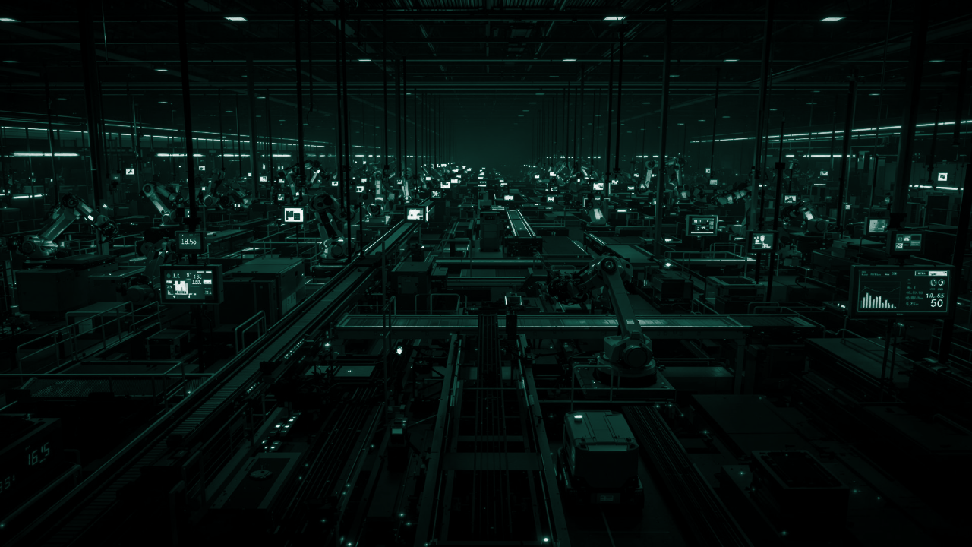


THE FUTURE OF US MANUFACTURING
MUST BE LIGHTS OUT
ROBOTIC AUTOMATED INDUSTRIAL AUTONOMY
Due to labor and skills shortages, there is no alternative
…however most companies are unprepared
Notes:
These days an increasing number of people recognize that the future of manufacturing is Lights Out
The lack of skilled labor and aging workforce demand far greater levels of automation as we look to build out
and re-establish our production capabilities in medical & pharmaceuticals… in defence & space… in semiconductors & electronics… and in numerous other industries
Yet, most companies are ill-equipped to achieve the levels of autonomy necessary in the time frame required (CLICK)

Slide 3
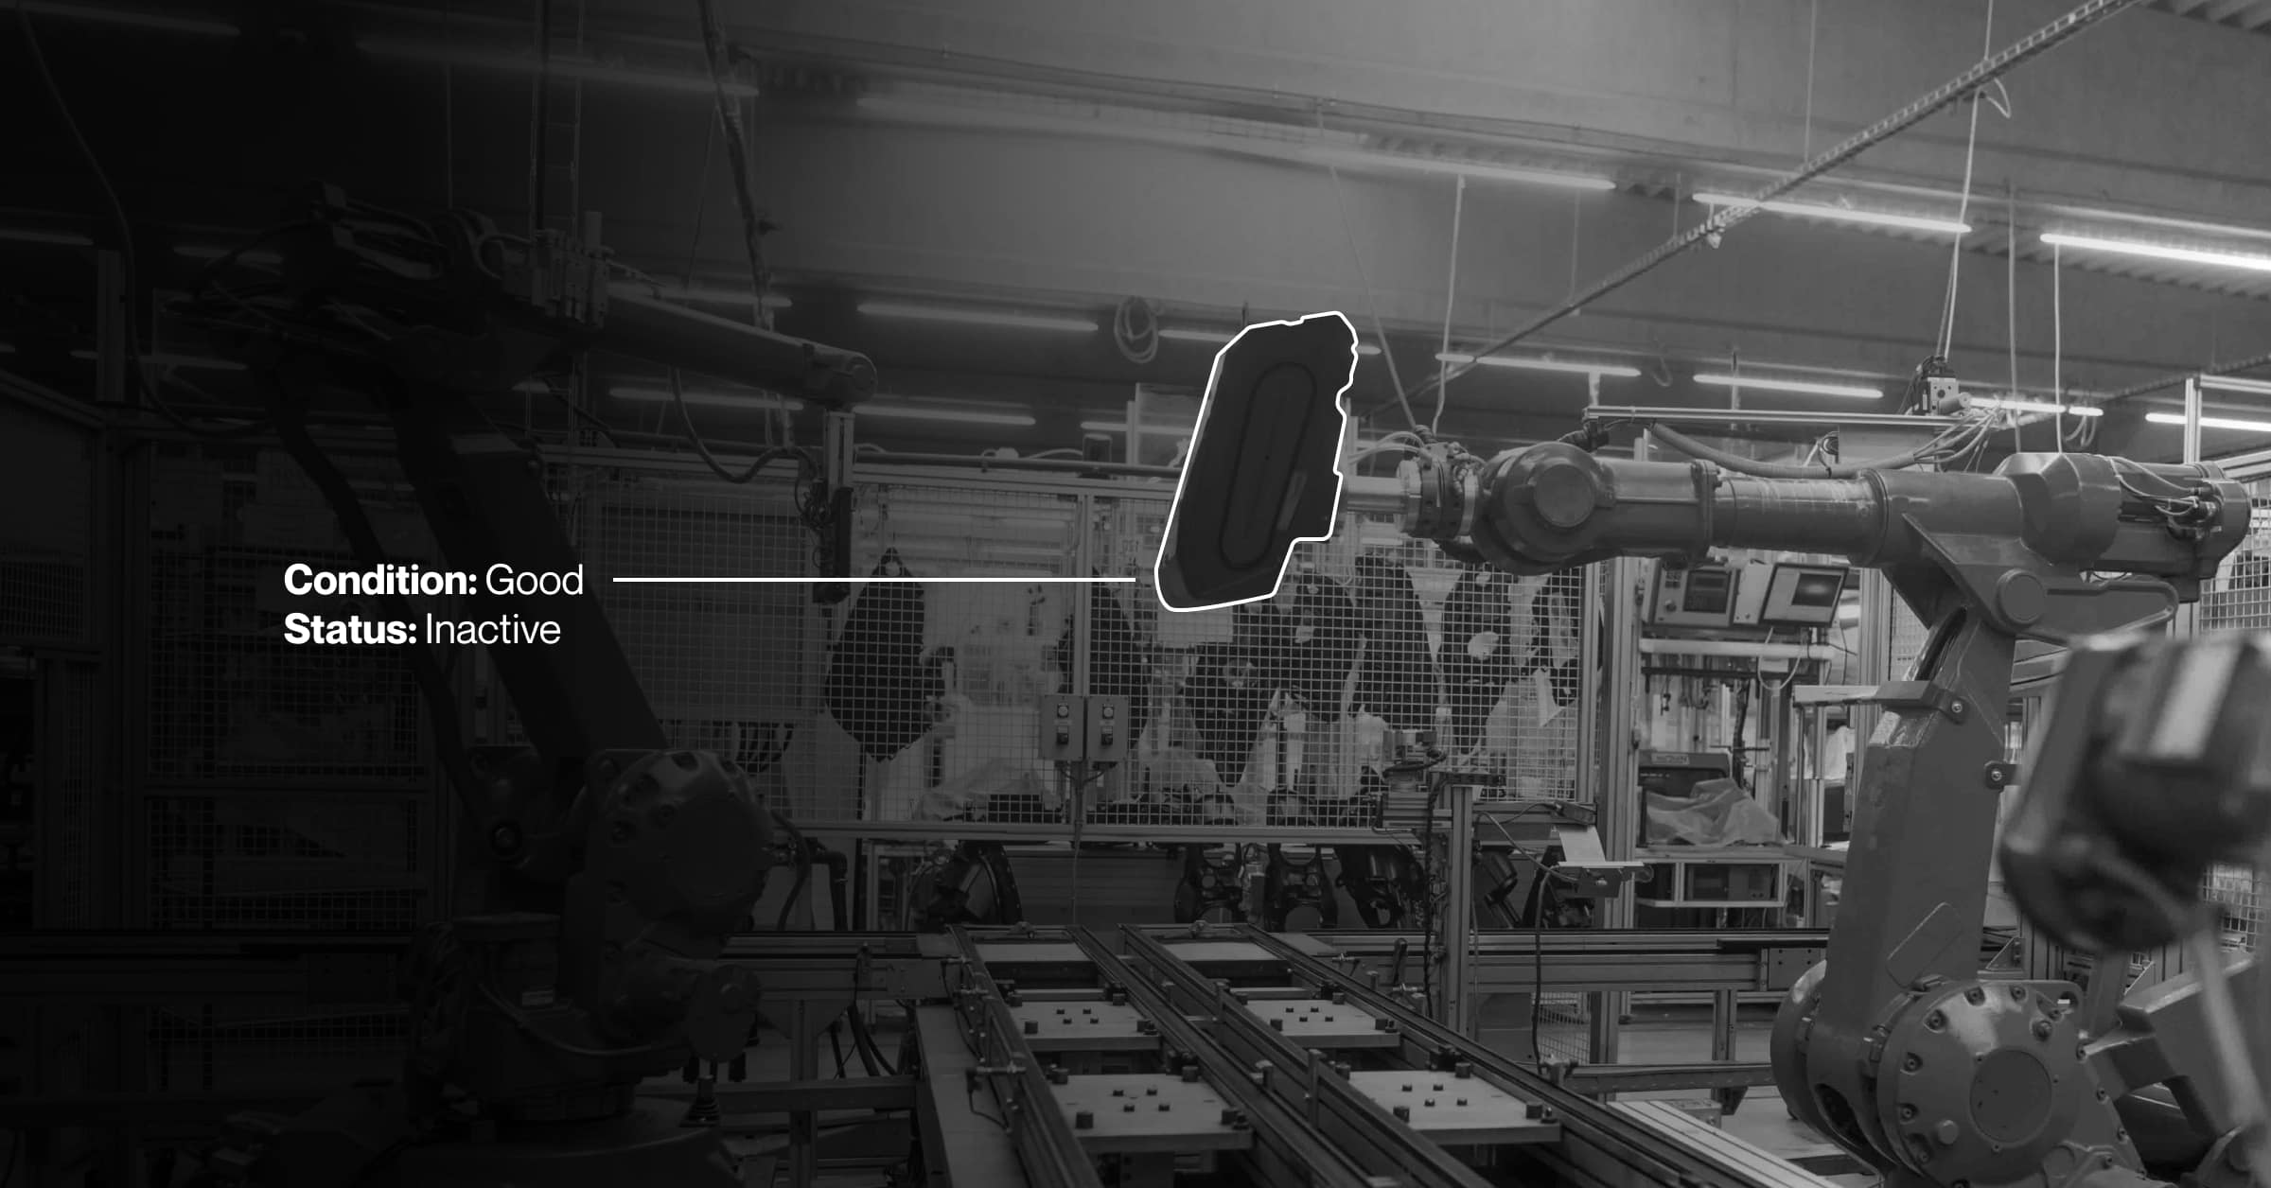
THE PROBLEM
Notes:
The Problem is… automation is Complicated… and more importantly difficult to scale
Most Smart Factory initiatives Breakdown at the Workcell level where the rubber meets the road… or the robot meets the machine
(CLICK)
Companies Can’t get Robots working…
They’re Disconnected
Equipment is incompatible…
and they Lack Process Integration so nothing’s synchronized

Slide 4

SMART FACTORY PRODUCTION ROBOTICS MATURITY MODEL
Conventional Factory Production
Traditional
Machine
Tending
Robotic
Process Enablement
Autonomous Process Control
Robot-Driven
Manufacturing
Humans Manually Run Machines
Robots Load/Unload Machines
Robots Incorporated
into Process Workflows
Robots Run Workflows
with Realtime Feedback
Fleets of Robots
Across Smart Factories
Notes:
Our solution is focused on bringing applications from a conventional, manual process into a robot enabled workflow that can scale from cells, to fleets, and to a smart factory.

Slide 5
SMART FACTORY PRODUCTION ROBOTICS MATURITY MODEL
Conventional Factory Production
Traditional
Machine
Tending
Robotic
Process Enablement
Autonomous Process Control
Robot-Driven Manufacturing
Humans Manually Run Machines
Robots Load/Unload Machines
Robots Incorporated
into Process Workflows
Robots Run Workflows
with Realtime Feedback
Fleets of Robots
Across Smart Factories
Benefits
Status Quo / Well Understood
Human Operators ability to deal with Ambiguity
Challenges
Operator Hiring, Morale, Retention
Skills & Training
Safety / OSHA / Injuries
Benefits
Initial Efficiency Gains
Incremental Capacity Improvement
Challenges
Incompatibilities
Lack of Process Integration
Periodic Down Time Occurrences
Benefits
Greater Throughput
Significant Capacity Increases
Challenges
Machine-to-Automation Interfacing
Workflow Process Coordination
Benefits
Defect Avoidance
Scrap & Rework Reductions
Higher Yields
Challenges
Closed-Loop Control & Coordination
Real-Time Parameter & Variable Adjustments
Benefits
“Lights-Out” Autonomy
Utilization Maximized
24/7/365 Capacity
Challenges
Multi-Asset Interoperability
Factory-wide Automation Orchestration
Notes:
As companies progress thru the Maturity Model, the Benefits and Payback increase in step functions as greater levels of automation competence are achieved
There are also a series of Challenges at each stage that can complicate implementations and adversely impact results (CLICK)

Slide 6
SMART FACTORY PRODUCTION ROBOTICS CHASM
Conventional Factory Machining
Traditional
Robot
Machine Tending
Robotic
Process Enablement
Autonomous Process Control
Robot-Driven
Manufacturing
Initiatives Fail
Humans Manually Run Machines
Robots Load/Unload Machines
Robots Incorporated
into Workflow Process
Robots Run Workcells
with In-line Inspection
Fleets of Robots
Across Smart Factories
Can’t get Robots Working Properly…
Disconnected… Can’t talk to Machines
Incompatibilities… Don’t work Together
Lack of Process Integration… Not Synchronized
with overall Operations
Smart Factory
Robotics
Chasm
Unable to Rollout Broadly
Notes:
The problem is that most companies fail early on when deploying production robots… we call it the Smart Factory robotics Chasm…
They can’t get the Robots working properly because
They’re Disconnected
Incompatible
And lack Process Integration
So they’re unable to roll them out across the Production Environment (CLICK)

Slide 7
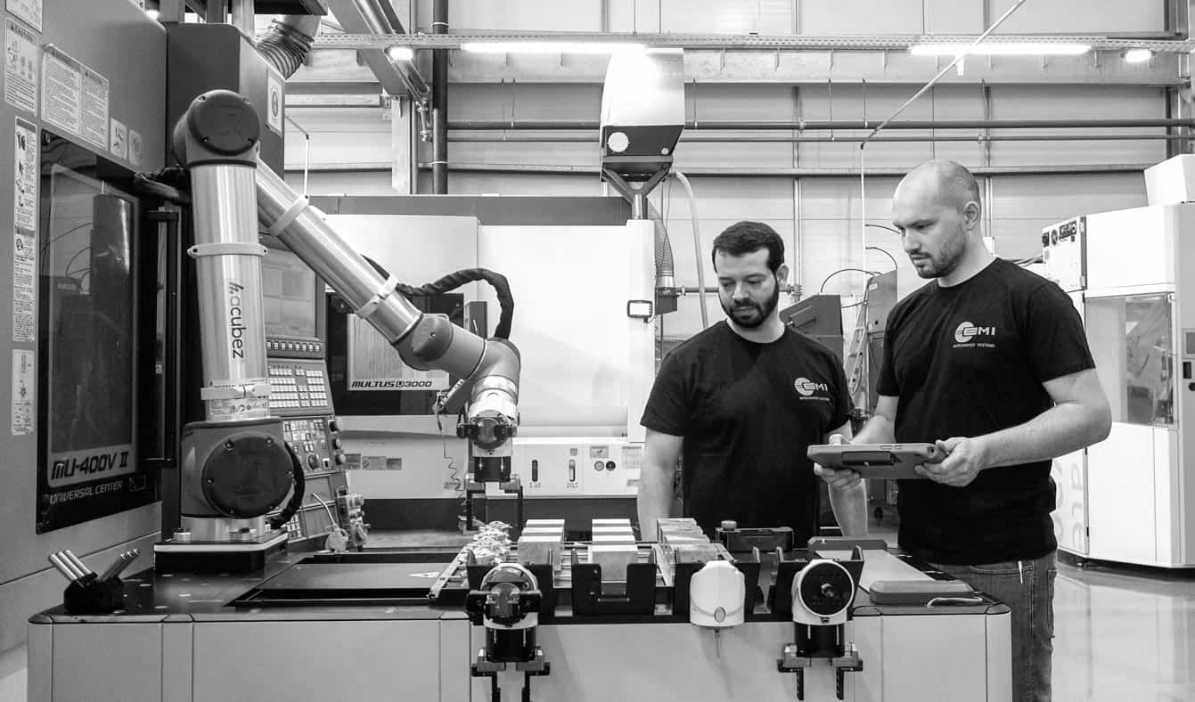
CURRENT STATE = CUSTOM INSTALLATIONS
Hardware Locked Custom “One-Offs”
Long + Hard + Expensive
Complex to Install, Operate, Maintain
Stand-Alone Data Silos / Not Ready for AI Robot Future
Notes:
This is because Today, these deployments are done as Custom “One-Off” implementations
Which are Complex to Install, Operate and Maintain
They’re different for each installation, and because they’re disconnected they create Data Silos and are not ready for the AI robot factory of the future
Why is this still the case? (CLICK)

Slide 8
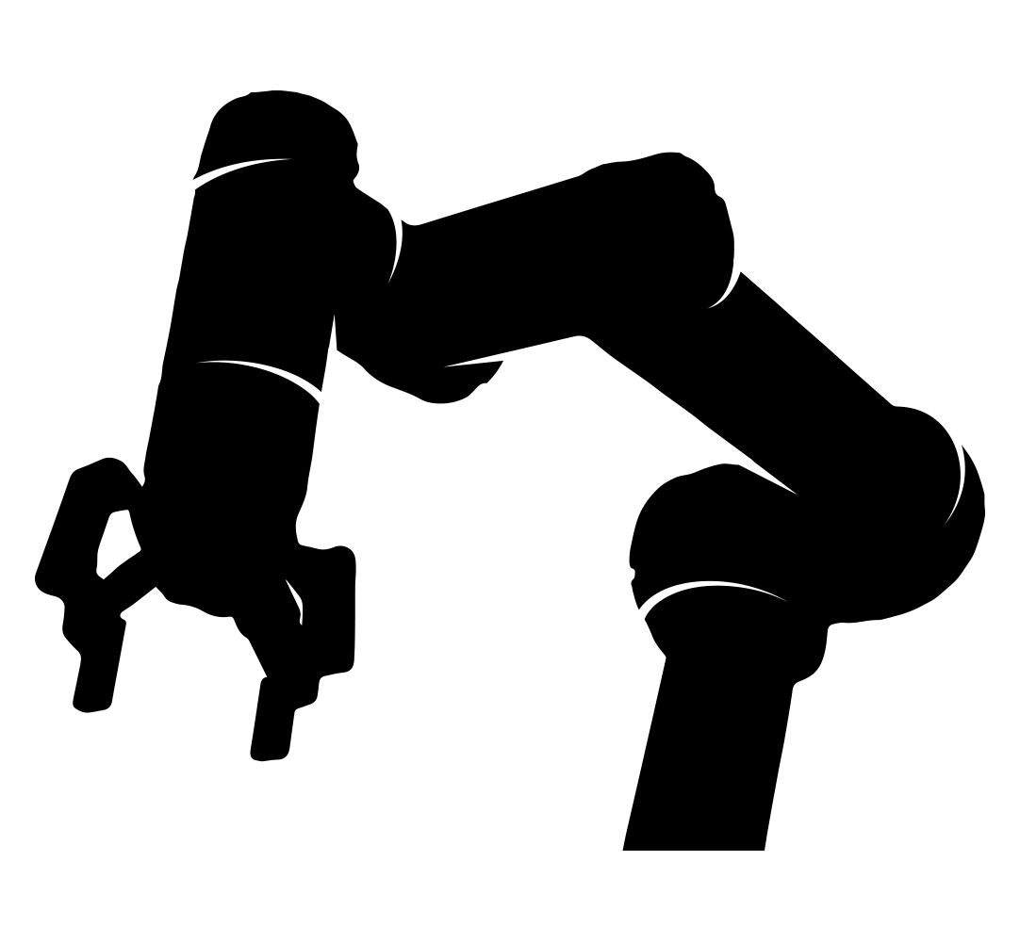
CURRENT MANUFACTURING TECHNOLOGY STACK
Level 4
ERP
?!
Level 3
MES / MOM
Level 2
SCADA / HMI
Level 1
PLC
Level 0
Sensors & Signals
ISA-95 Enterprise-Control System Integration Model
Notes:
Well… when we look at the current manufacturing technology stack and existing systems…
They don’t comprehend the Robot (CLICK)

Slide 9

INCOMPATIBILITIES EVERYWHERE
Level 4
ERP
Numerous Open & Proprietary Protocols
OPC/UA
MTConnect
Modbus-TCP
TCP/IP
Ethernet/IP
DeviceNet
MELSEC
Profibus/Profinet
other proprietary controllers
and interfacing protocols
Level 3
MES / MOM
Level 2
SCADA / HMI
Level 1
PLC
Level 0
Sensors & Signals
ISA-95 Enterprise-Control System Integration Model
Notes:
And at the foundational level, there are Incompatibilities everywhere… which means nothing works together seamlessly…
And that makes everything including robots complicated to implement (CLICK)

Slide 10
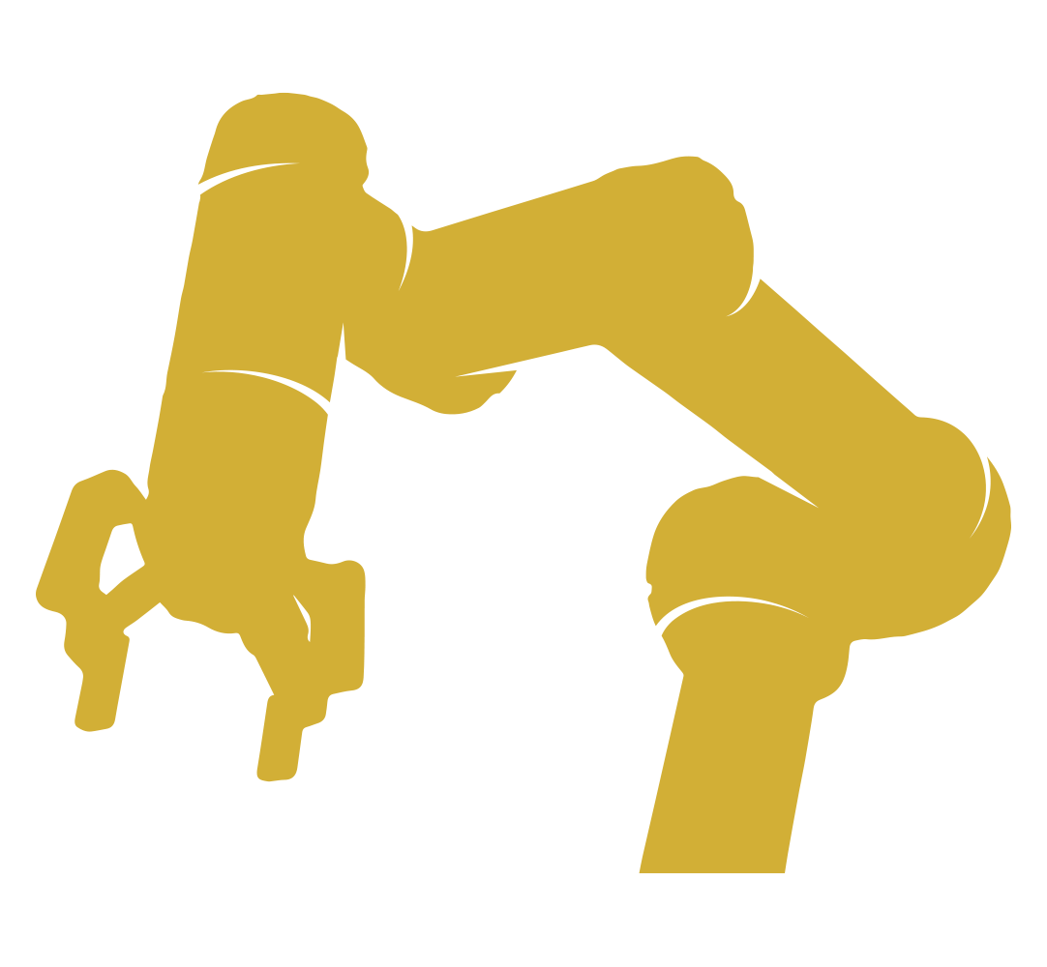
SOLVING THE PROBLEM
Level 4
ERP
Mills
Robots
Cobots
5-Axis
CMM
Level 3
MES / MOM
Lathes
Vision
Modern Approach to Software-Driven Automation
Turning Centers
Lasers
Level 2
SCADA / HMI
Swiss
Probes
Standardized capabilities for
universal communication and orchestration of automation and robotics with machines, equipment, and systems
Additive
Telecentric
Level 1
PLC
Multi-Tasking
PCB Testers
Press Brakes
PLC
Drill & Tap
CNC Grinders
Level 0
Sensors & Signals
EDM
Laser Markers
Deburring
ISA-95 Enterprise-Control System Integration Model
Notes:
To solve these problems and scale automation repeatedly across the factory in a future-ready way… we believe a Modern Approach towards Software-Driven Automation is needed…
This means standardized capabilities that are not hardware dependant and include universal communication & orchestration of automation equipment (CLICK)

Slide 11































BREAKTHROUGH INNOVATION
TM
FLEXXCORE
Mills
Robots
Cobots
5-Axis
CMM
Lathes
Vision
Software-Driven Autonomy
Unlocks factory equipment
Turning Centers
Lasers
Swiss
Probes
Additive
Telecentric
interoperable communication & orchestration
Multi-Tasking
PCB Testers
What is FlexxCORE?
Compatibility with 1000+ makes & models of factory machinery
Low-code environment for composing and running Transformers, powerful driver connectors. Includes a secure, high performance run-time framework for data pipelines with protocols, class structures, method sets, and data models for development.
Transformers enable bi-directional read/write interoperability between robots and factory equipment for communication, coordination, and closed-loop real time programmatic adjustments.
Press Brakes
PLC
Drill & Tap
CNC Grinders
EDM
Laser Markers
Deburring
Notes:
FlexxCORE is our breakthrough innovation which provides compatibility with over a 1000 makes & models of factory machinery and equipment
It enables Robots to “Talk” to multiple machines simultaneously to coordinate their production for Autonomous Manufacturing (CLICK)

Slide 12
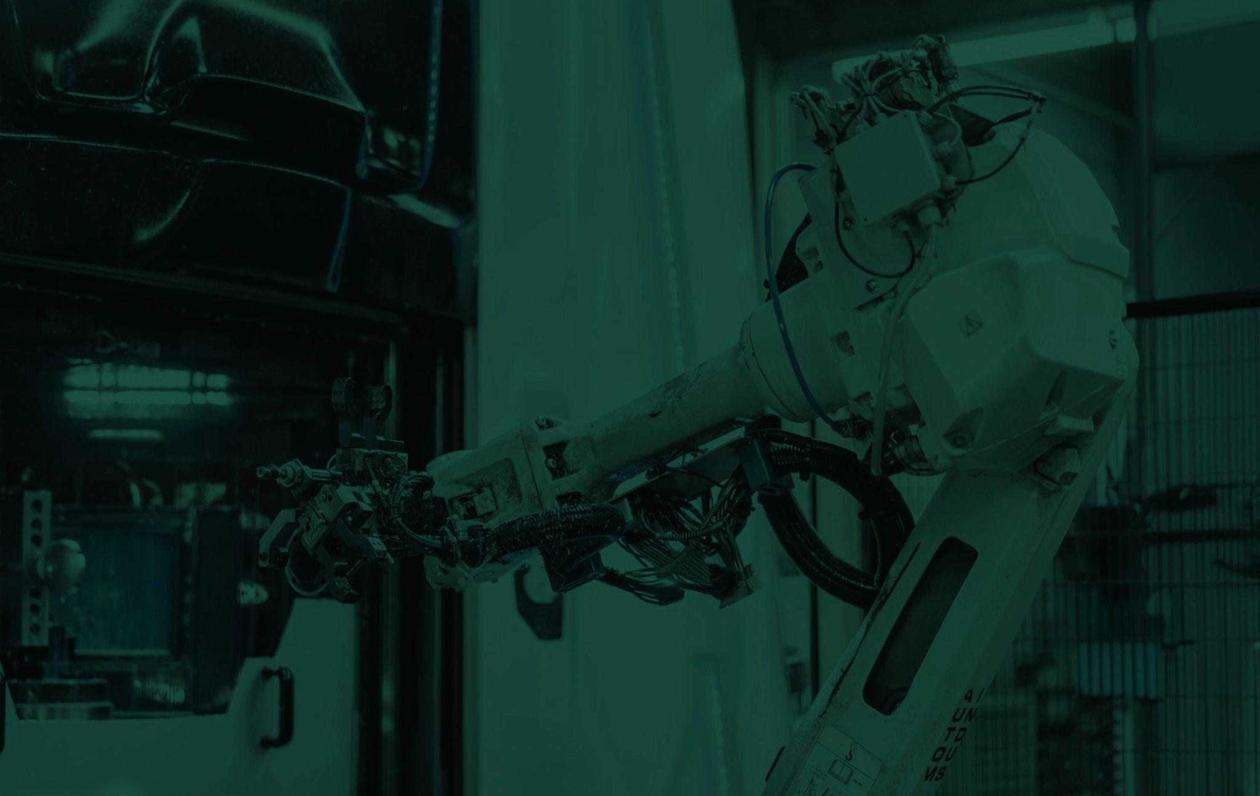

Connect
Communicate
Powerful and modular autonomous manufacturing platform that makes
robots talk to machines and coordinate work for ‘lights out’ production
Standardized software-driven autonomy capabilities deliver universal communication and orchestration of production robotics with machines, equipment, and systems across smart factories
Coordinate
Command
Control

Slide 13
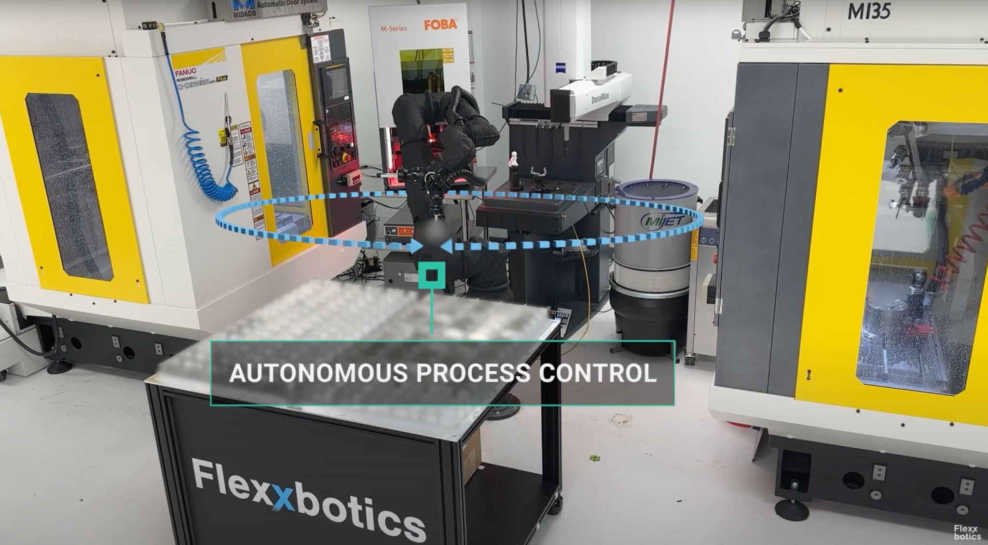
PROCESS CONTROL NECESSITY
Closed-Loop Software Driven Adjustments
Notes:
Going back to the maturity model, step 4 Autonomous Process Control or APC is rarely acknowledged… when using automation to gain greater levels of manufacturing autonomy, a crucial step is achieving a repeatable and consistent process
That means Closed-Loop Control with Parameter and Variable updates must be occurring in real-time… this is a necessary prerequisite for true Autonomous Manufacturing without human intervention (CLICK)

Slide 14
EXAMPLE PRODUCTION DEPLOYMENT
Notes:
Now let’s take a quick look at a Real-World production deployment that we’ve done for a medical customer making Class 3 implantable devices subject to FDA compliance and traceability requirements (CLICK)

Slide 15
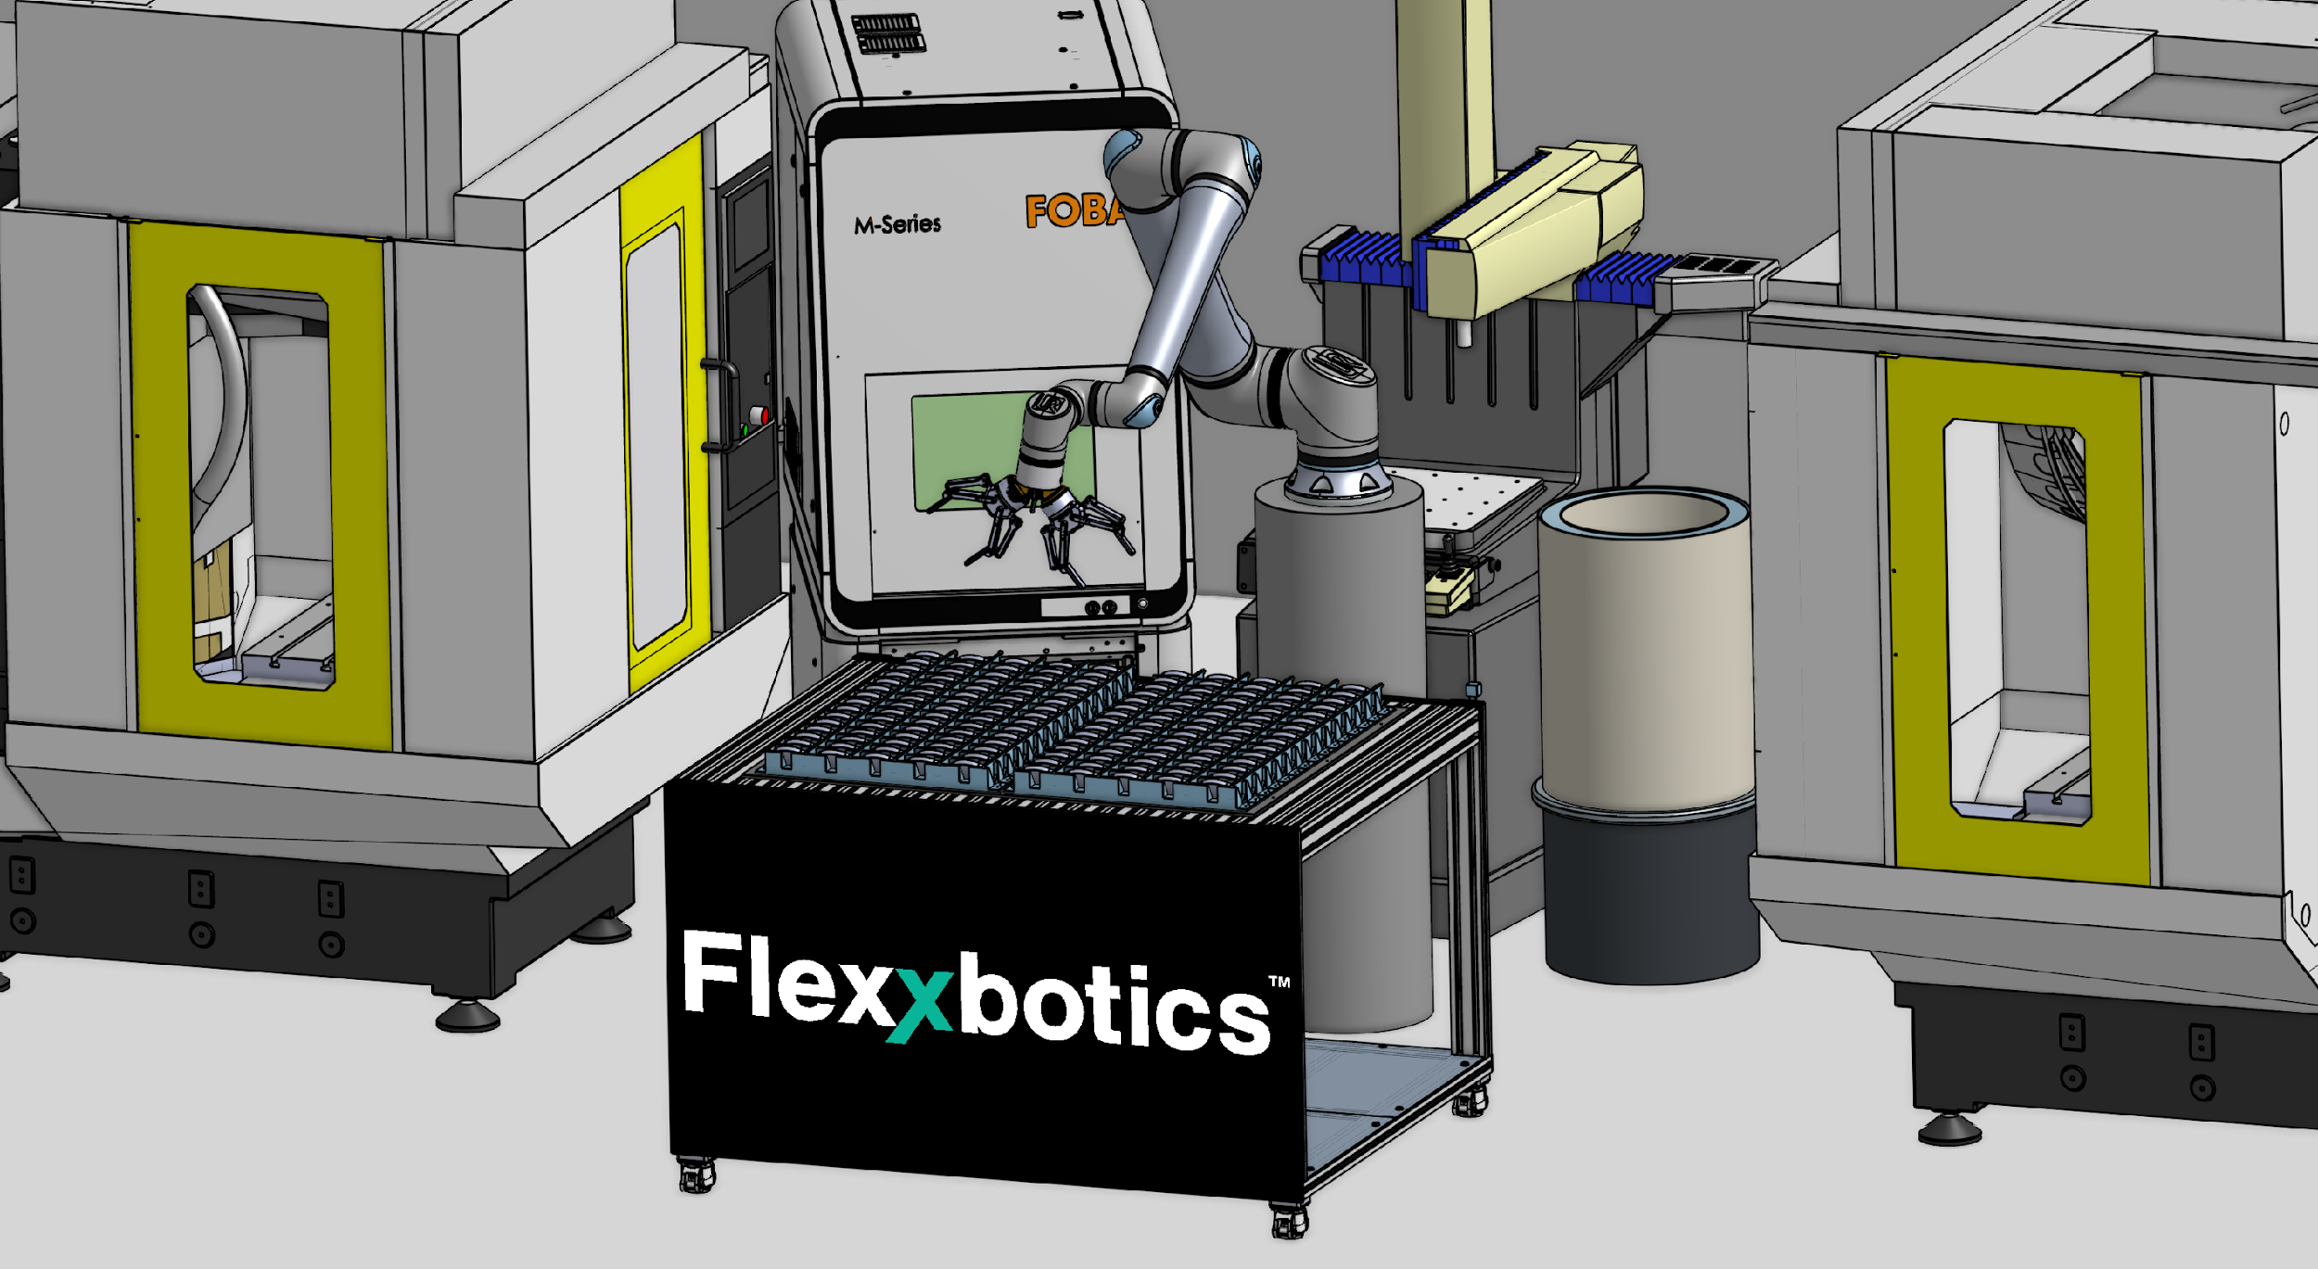
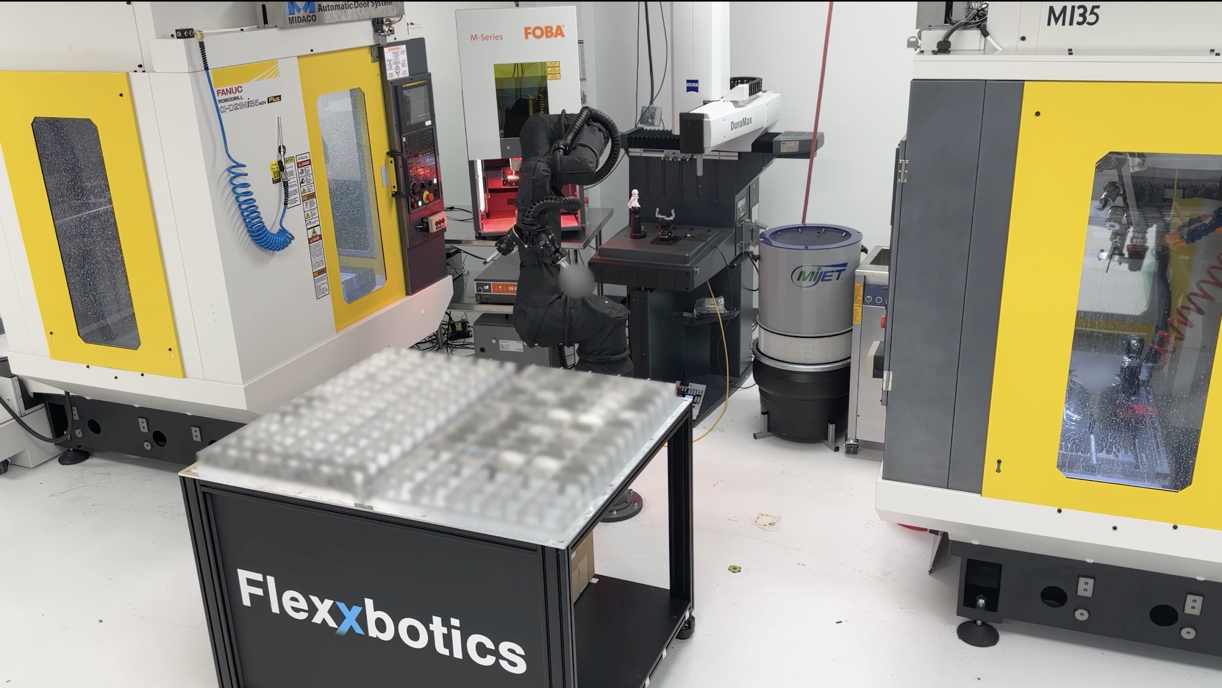

DIGITAL-TO-REALITY TRANSFER
DIGITAL WORLD
REAL WORLD
seamless
transfer
https://flexxboticsinc.com/1wef
Multi-Machine Automation Cell Digital Twin Emulation
Multi-Machine Physical Implementation
extend simulation tools with multi-machine automation interfacing emulation
to model interoperable communication & orchestration then deploy in real world
Notes:
First with any deployment, we start with a Digital Twin simulation that includes emulation of all equipment in the cell with robot automation and our software orchestrating the entire cell
Then, because the Software-Defined Automation is portable, we deploy it seamlessly to the actual physical equipment in the factory (CLICK)

Slide 16

SOFTWARE–DRIVEN AUTOMATION IN ACTION
https://flexxboticsinc.com/1wef
Notes:
(CLICK >> RED PLAY BUTTON)
So what does that look like in action
For this particular setup we are looking at a robot tending to 2 CNC machines, an ultrasonic bath, a drying station, a CMM, and a laser marker for Unique Identification serialization.
The robot starts by loading the first CNC machine to perform op1 which is machining the top side of the part
It then removes a part from op1 and loads it into the second CNC machine to perform op2 which machines the bottom side of the part.
The part then gets removed from op2, immediately gets cleaned and dried, and then gets placed onto the CMM for inspection.
Once the CMM routine is complete, one of two things will occur:
the part will either pass inspection… in which it gets moved onto the laser marking system where it is marked with a lot number and serial number and then loaded back into the finished parts side of the pallet
or
fail inspection… in which the part is either placed into a failure bin or reworked.
With this setup at any given point, there are 3 parts simultaneously being processed and it can do this for 14 hours of unattended time.
All of the coordination between the robot and machines is being orchestrated by standardized software automation and this is enabled by the interoperable communication between the machines. The software contains read/write interfaces that can communicate with all 6 of these pieces of equipment.
Our software is responsible for starting each of the respective equipment cycles and capturing the state and data coming from of each piece of equipment to determine what needs to be done next and contextualize the data for automation traceability and compliance.
So what’s a tangible takeaway of autonomous process control in this setup. Take for example the inspection routine. We are using the software-driven automation logic to analyze over 40 critical dimensions from the CMM output and also derived from the QMS. We then determine if a machine offset is needed to bring the production parts back to target spec and stay within tolerance. This is just one of many examples of APC in production environments
(CLICK)

Slide 17
ENTERPRISE BENEFITS
Operational Benefits
Secondary Operation
Business Benefits
Faster Set-up
Greater Throughput
Machine
Inspection
Coordinated Operation
Longer Unattended Runs
Closed-loop Quality
SOFTWARE-DRIVEN AUTOMATION
More Capacity
Automated Change-over
Higher Yields
Less Downtime
Increased Profit per Part
Notes:
The benefits of this Software-Driven Automation approach for customers like the one we showed and others is both impactful and rapid.
The two most important business outcomes in my opinion are Greater Throughput and Increased Profit Per Part. These two business outcomes culminate from the operational benefits of Faster Setups, Automated Changeovers, Longer Unattended Time, Improved quality and Reduced downtime(CLICK)

Slide 18
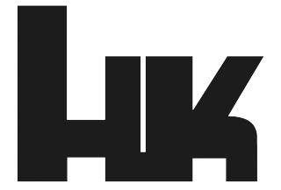
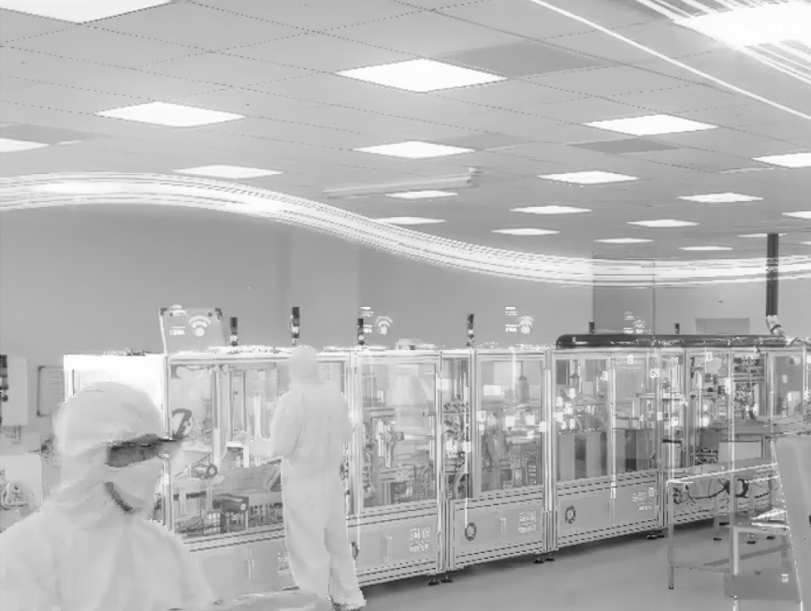
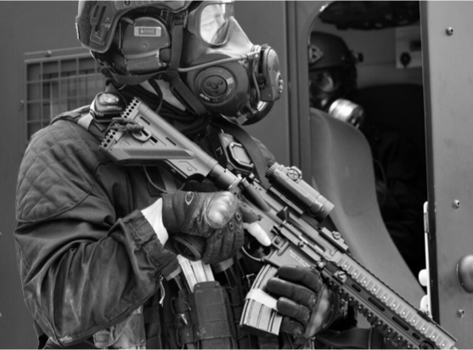

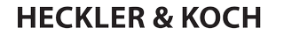
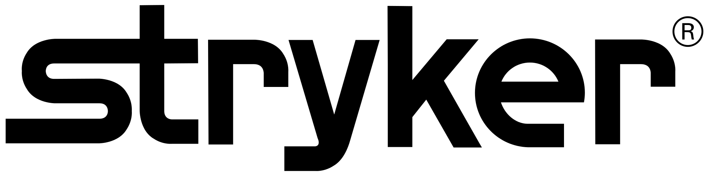

FLEXXBOTICS IN ACTION
RESULTS
83% Cell Utilization
52% Scrap Reduction
RESULTS
41% Throughput Increase
62% Downtime Reduction
RESULTS
89% Downtime Reduction
12% Utilization Improvement
“
Scalability was a key criteria in our selection process as we plan to roll-out the solution across more than 100 machines in our factory, which Flexxbotics makes possible.”
William Hoose
Plant Manager
EIS Engineered & Industrial Solutions
Notes:
Our software is delivering real business results in production deployments at industry leading companies
83% cell utilization at Heckler & Koch enabling them to scale up production of assault rifles for Ukraine
Over 40% throughput increase for Stryker to deliver much needed orthopedic equipment to hospitals
and an 89% reduction in Downtime to keep EIS Engineered Industrial Solutions producing energy infrastructure for the AI data center build out (CLICK)

Slide 19
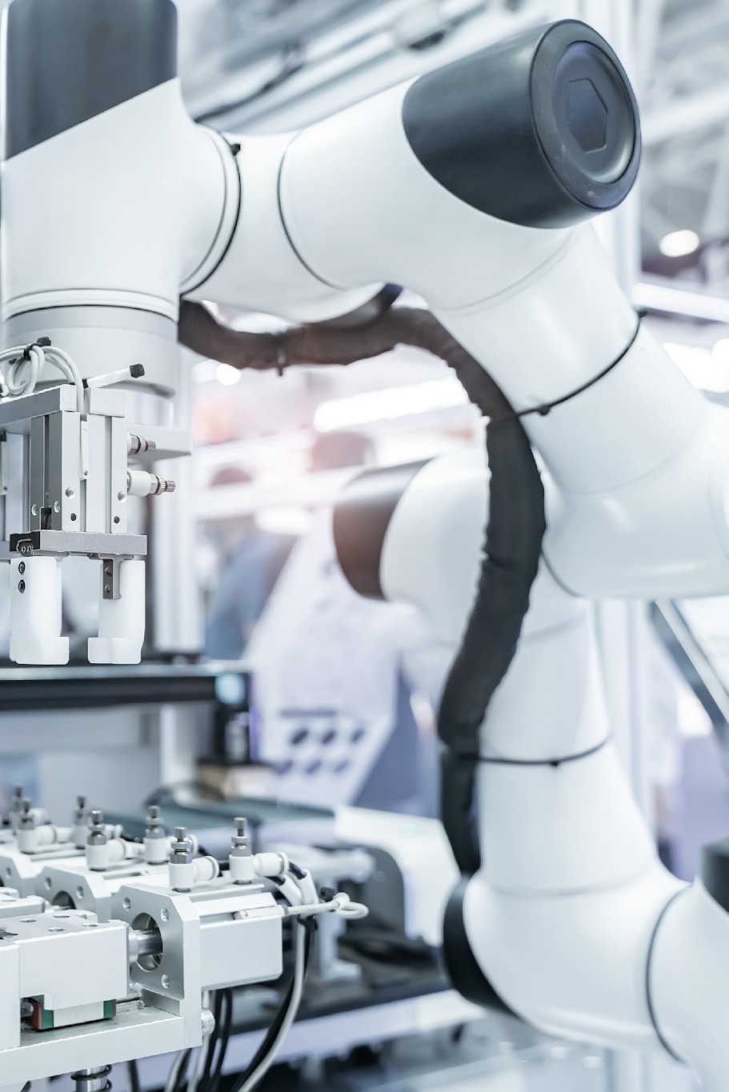


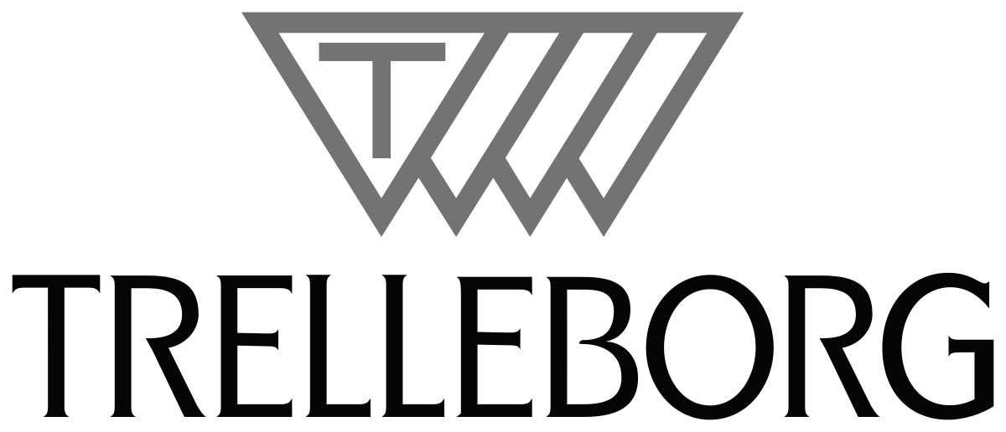
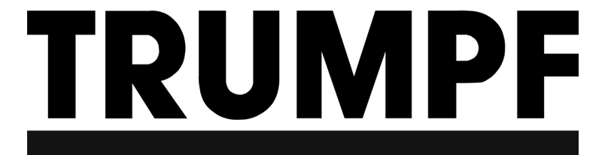
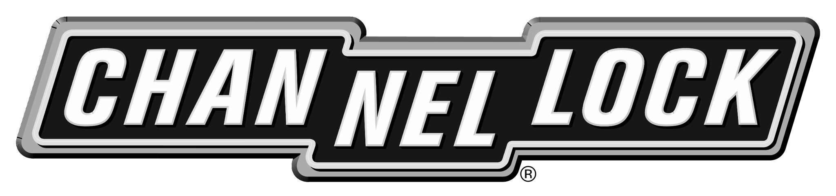
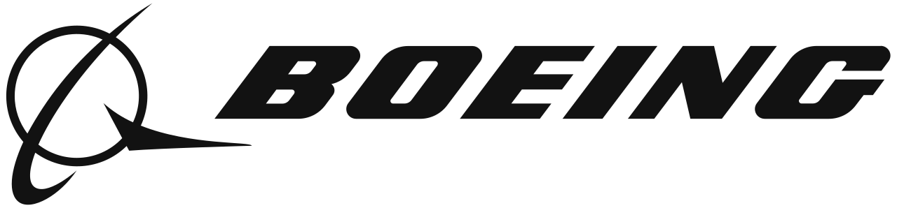


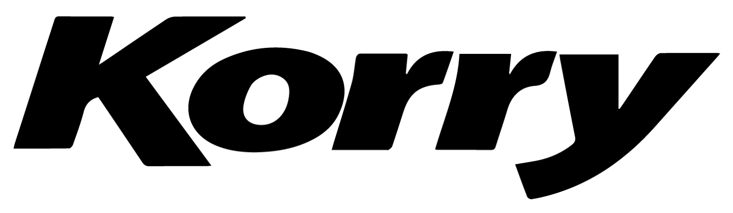

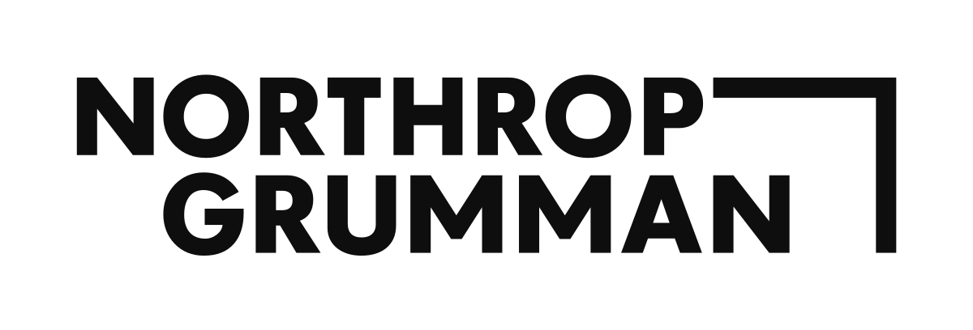
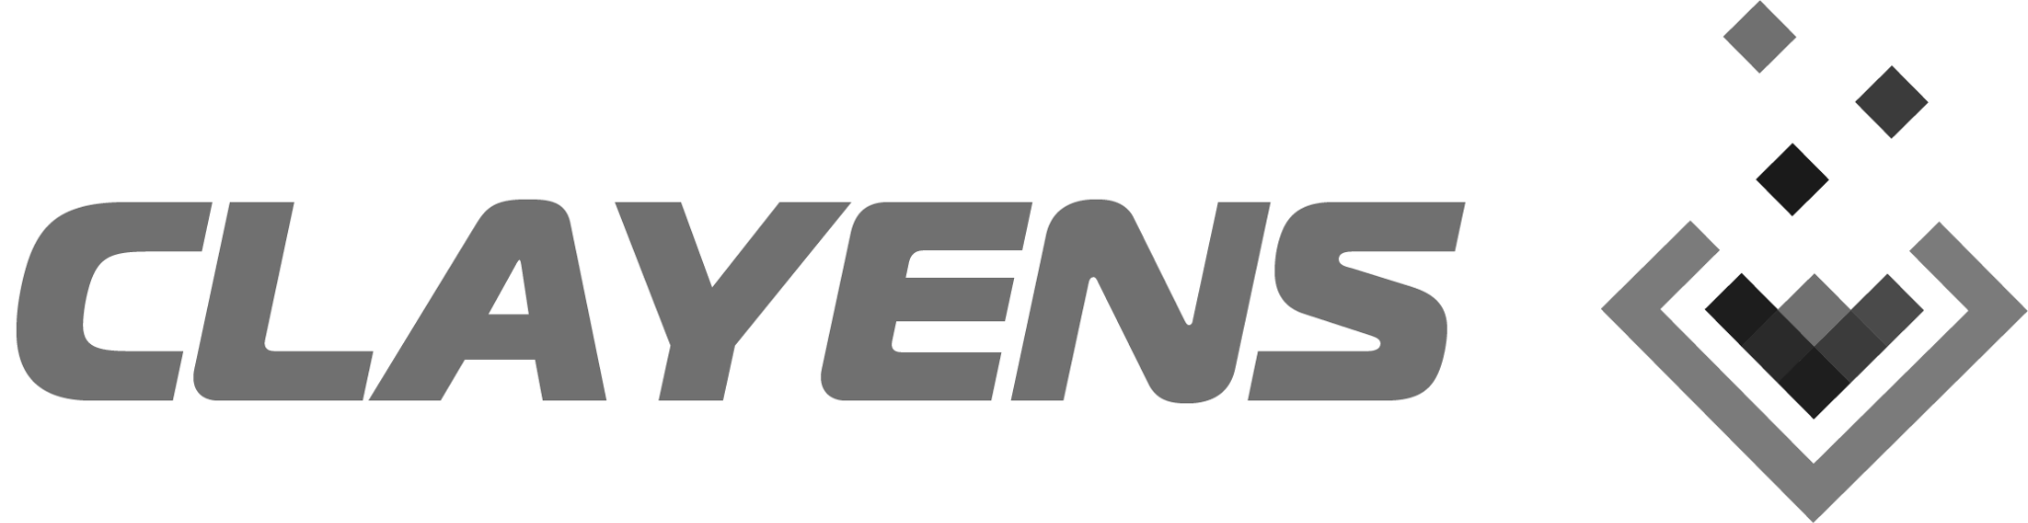

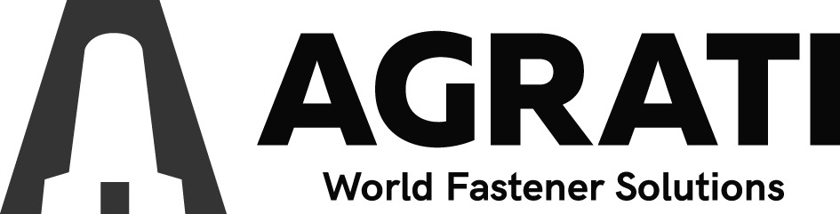

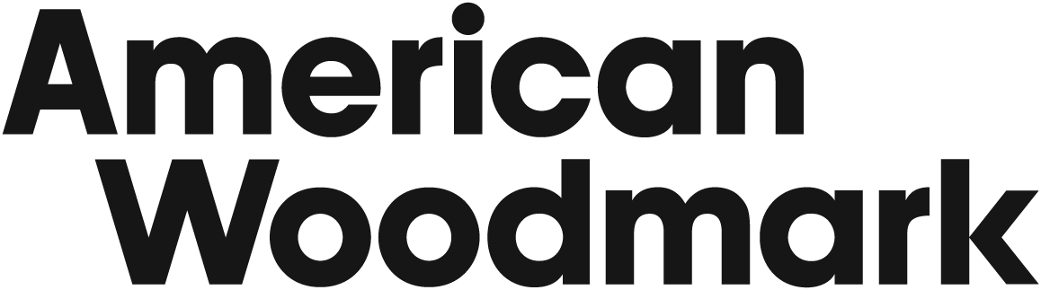



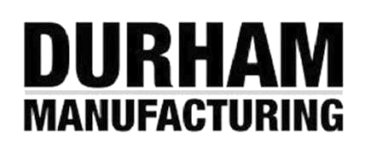
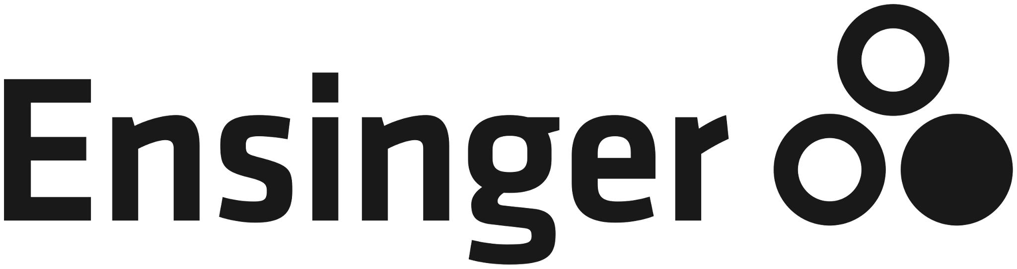




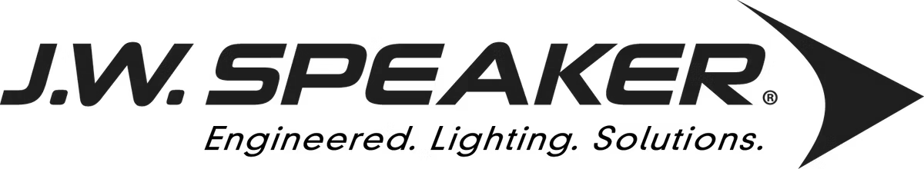
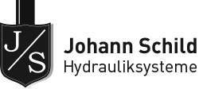


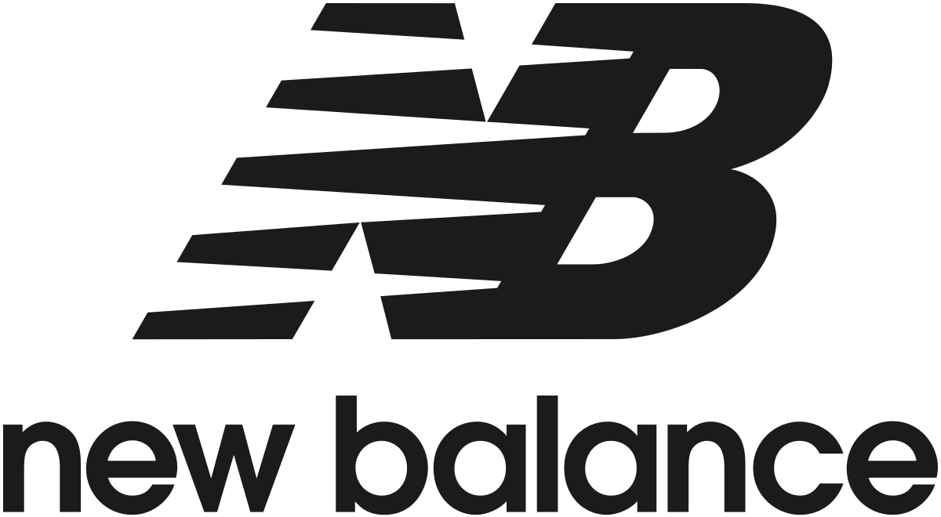

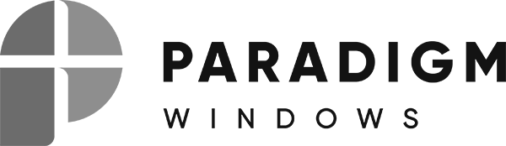
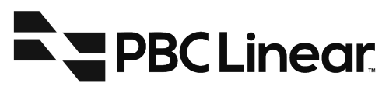
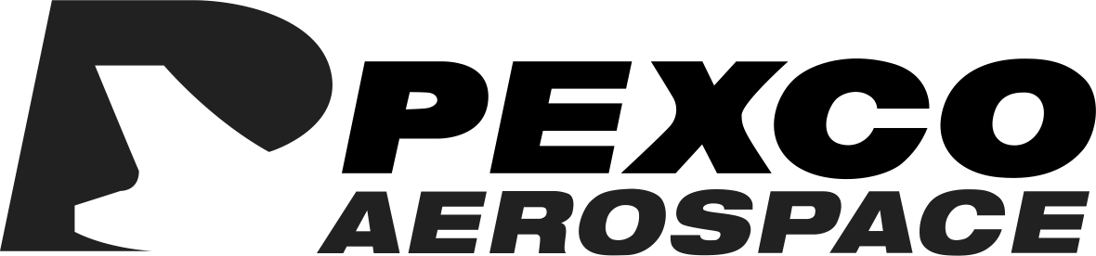
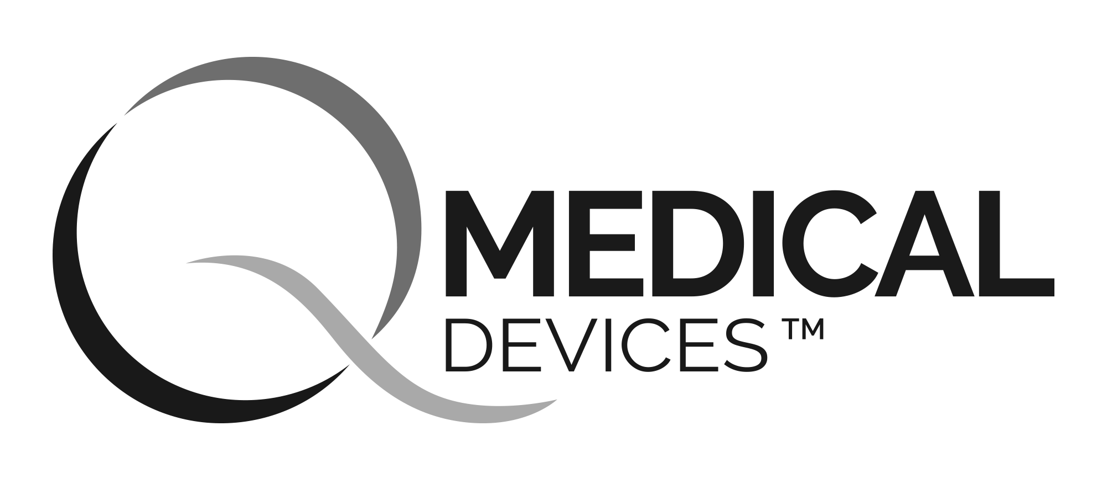

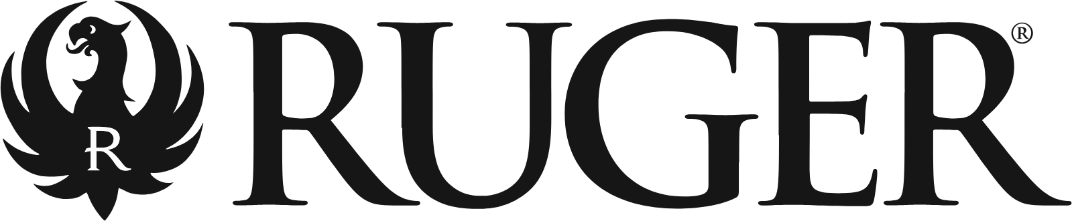

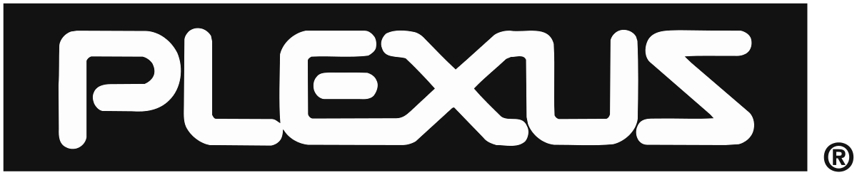
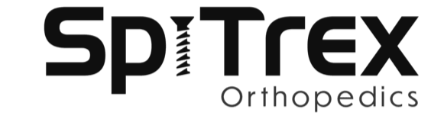


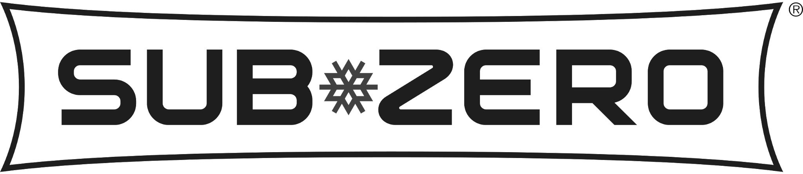

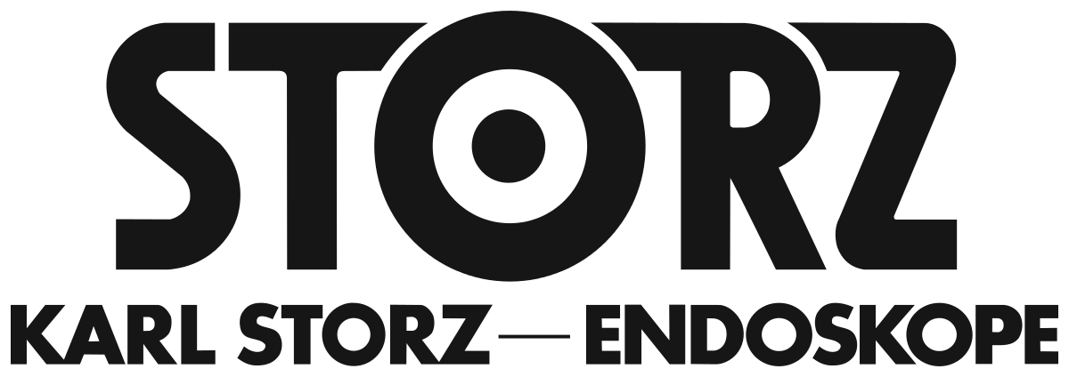



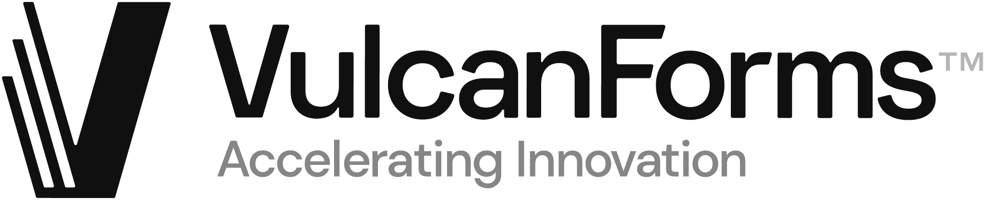
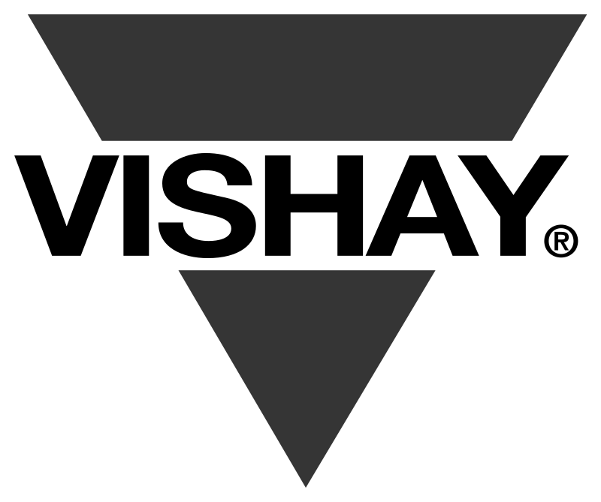


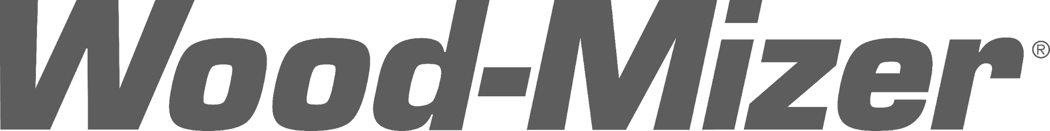
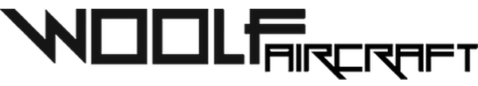

FLEXXBOTICS CUSTOMERS
Notes:
Flexxbotics customers come from all kinds of industries and demand a wide range of capabilities: from Orthopedic Rods to Collar clamps.

Slide 20
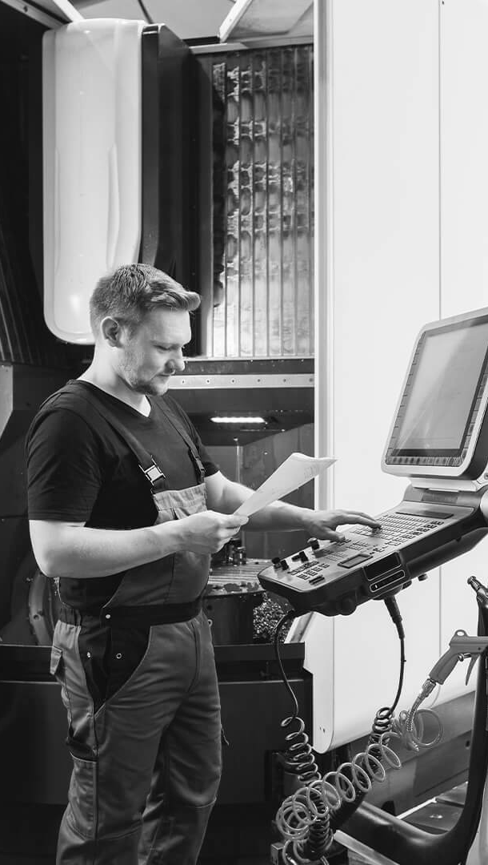
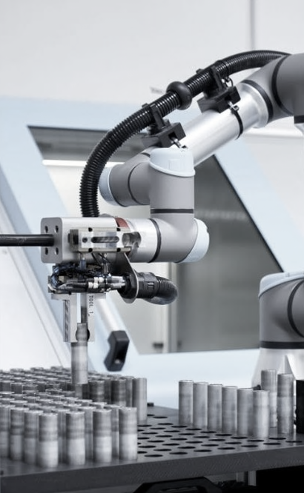
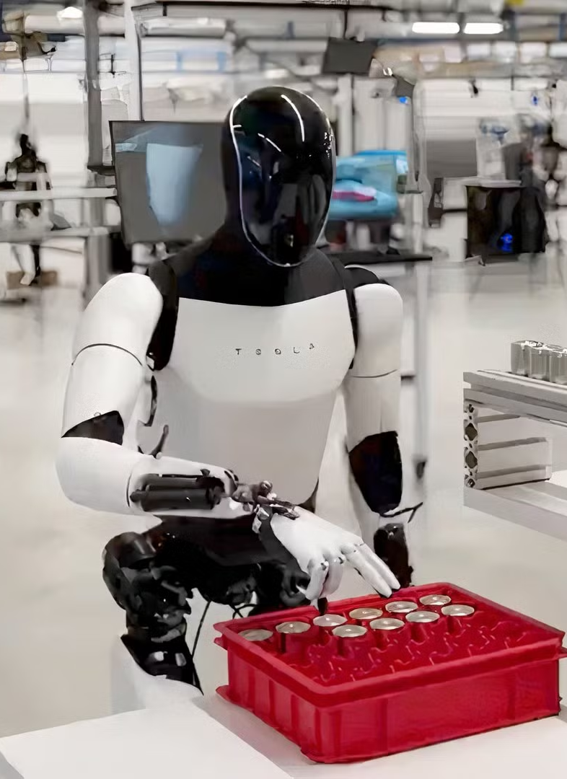
Yesterday
Today
Tomorrow
Source: Tiger Coatings
Source: UR
Source: Tesla
Notes:
Because we all know where this is heading… yesterday humans ran the factory, today industrial robots are increasingly important
And in the very near future, Humanoids will be introduced and scaled out in a wide range of areas (CLICKS)

Slide 21








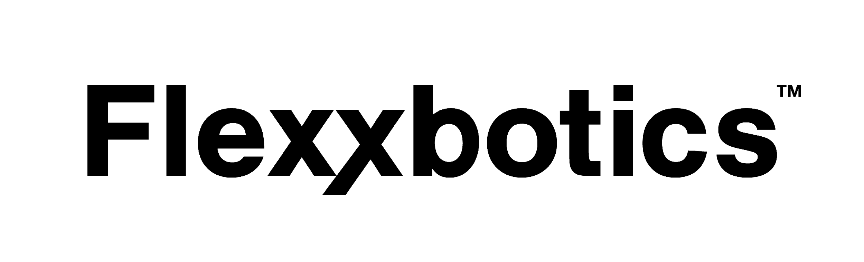











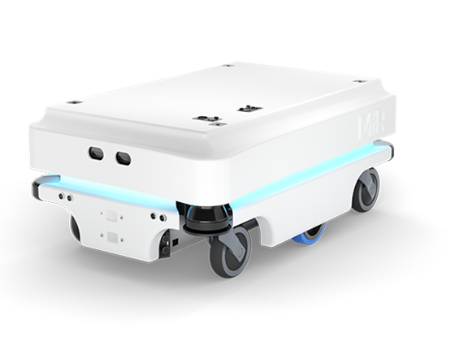
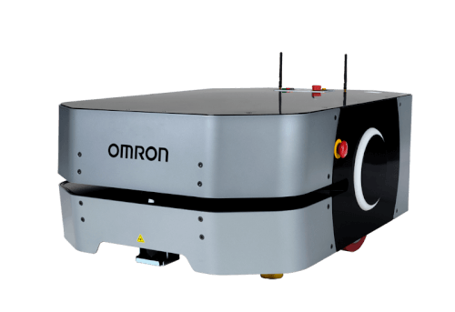
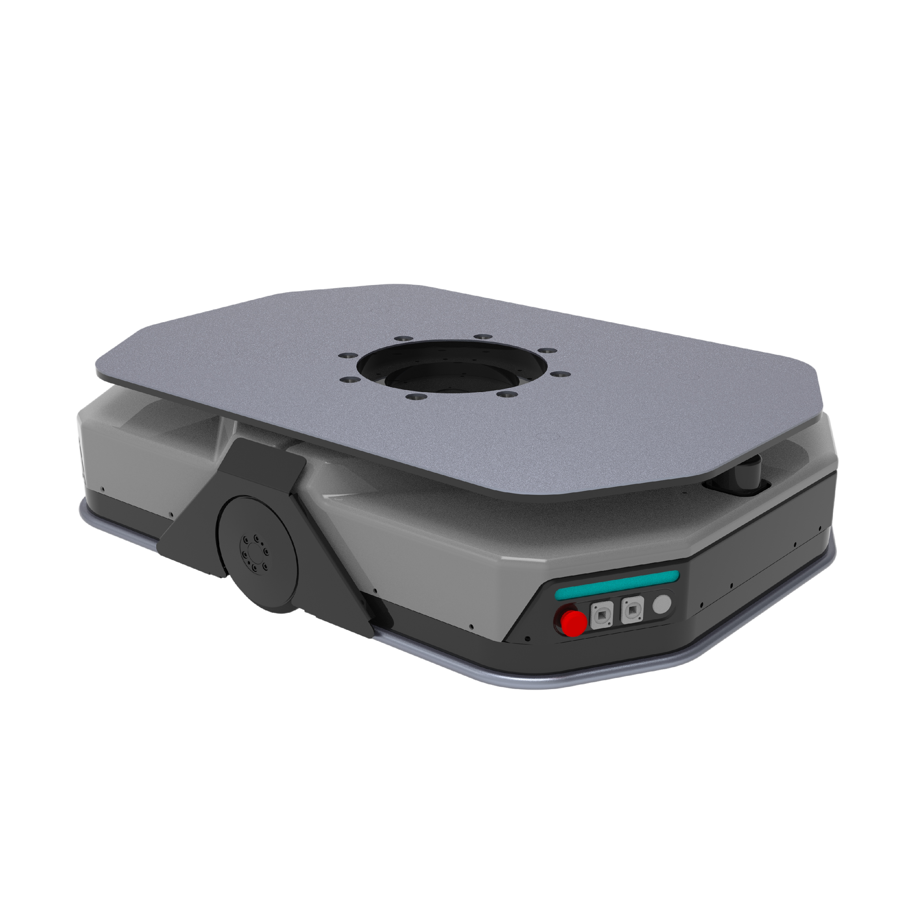




ENTERPRISE ARCHITECTURE
FlexxCore enabled Humanoid interoperable communication & orchestration
Existing Systems
ERP/MRP
Deburring
Laser Etching
Honing
EDM
Polishing
5-Axis
Inspection
Vertical Mill
Inspection
Horizontal Mill
Inspection
5-Swiss Lathe
Inspection
Additive
Inspection
PLM/CAD/CAM
MES/QMS
Agentic Interoperability
Physical AI Orchestration
Prescriptive Optimization
AUTONOMOUS MANUFACTURING PLATFORM
SCADA/IIoT
PLC
PLC
PLC
PLC
PLC
Fleet Mgt
Inspection
Inspection
Inspection
Molding
Welding
Dispensing
Assembly
Machining
Machining
Machining
Test
Test
Test
Custom
AMR / AGV
Robot Integrated CNCs
Notes:
And as the Humanoids are rolled out We Believe they will need to take instructions from the Business Systems…
And will need to be able to “talk” to the machines as well as the other robots…
Which is where Flexxbotics comes in… we believe a Robotic Production Platform is necessary for Coordinated operations (CLICK)

Slide 22
THANK YOU | QUESTIONS
Tyler Bouchard
CEO & Co-founder, Flexxbotics
tylermb@flexxbotics.com

Slide 23
APPENDIX & MATERIALS

Slide 24
SOFTWARE & SERVICE OPTIONS

Slide 25
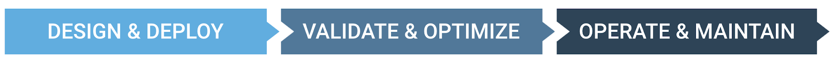



FLEXXBOTICS SERVICE OPTIONS
DESIGN & DEPLOY
Turnkey Production Robotic Implementation Experts
Complete project capabilities for successful deployment
Robotic
Machine Tending
Robot / cobot
End-of-arm-tooling
Part presentation
Pallets & feeds
Cleaning stations
Auto-doors
Workholdings
Modular engineering design
Integration & robot programming
Standardized machine interface
Safety & risk assessments
Factory & site acceptance (FAT/SAT)
Comprehensive training
Remote & on-site support
Robotic
Quality Control
Robotic
Production Lines

Slide 26

SAFETY
Flexxbotics utilizes strict safety policies for a safe workplace for our employees and customers
Flexxbotics follows ISO and OSHA guidelines to maintain safety:
Registered OSHA Member
Annual Safety Training Certs for Existing and New Employees
Risk Assessment Process
All robotic cells undergo risk assessment to international standards at Design, FAT, and Installation
EN ISO 12100 Safety of machinery
  ANSI B11.0 – Safety of Machinery
  CFR 1910.147, OSHA Control of Hazardous Energy 8 D6-85863 REV B
  CFR 1910 Subpart O, Machine Guarding
  CFR 1910.331 - .335, Subpart S - Electrical Safety
EN ISO 10218-1 Robots and robotics devices (adopted by US standard ANSI/RIA R15.06)
EN ISO 10218-2 Robots and robotic devices (adopted by US standard ANSI/RIA R15.06)
ISO/TS 15066 Robots and robotic devices
Notes:
Here’s a look at our safety compliance and the standards we take for our risk assessment

Slide 27

FLEXXBOTICS WORKSHOPS
Selection Workshop (Optional)
1 Day Onsite
Plant Walkthrough
Automation Candidate Identification
Automation Complexity Ranking
ROI Comparison
Discovery Workshop
1 Day Onsite
Detailed Identification of Requirements & Considerations
Project Scoping & Planning
Conceptual Design & Recommendations for:
  Automation Cell Layout
  Infeed/Outfeed, Fixturing, Part Changeover, etc…
  Secondary Operations: Deburring, Blow-Off, Washdown Station
  In-process Inspection
Operator Handoff
Production Efficiency Analysis
Comprehensive Pricing & ROI Justification Points
Cost:
Applied to project cost and price depending on scope of project
Cost: Applied to project cost and price depending on scope of project
Notes:
Our Workshops are onsite processes that allow us to get detailed application information to drive our in-depth automation proposals.
We take a look at the part SKUs, machines, and manufacturing process as a whole to develop a business outcome driven set of requirements for the automation.

Slide 28







WORKSHOP BENEFITS
Ensure Solution Aligns With Your Goals
1. Minimize Design Risk
2. Own Design Specs
Identify challenges early
Prevent detail oversight
Ensure design meets requirement standards
Use to scale throughout facility
Ensure competitive and accurate pricing
3. ROI Driven Decisions
4. Expert Insights
Design that boosts your bottom line
Make informed decisions
Leverage our automation expertise on 250+ projects
Notes:
Here’s another quick summary of the benefits of our Workshop

Slide 29
SOFTWARE PACKAGES
BASIC
Essentials for Automating
One Machine with Process Integration
MACHINE + ROBOT
ADVANCED
Closed-Loop Automation Control for
Multiple Machines in a Single Cell
MULTI-MACHINE
AUTOMATION CELL
FACTORY
Advanced Automation of
Multiple Cells in a Single Factory
MACHINES + AUTOMATION
AT A SINGLE SITE
ENTERPRISE
Advanced Automation Scaled Across
Multiple Smart Factories
MACHINES + AUTOMATION
AT MULTIPLE SITES
BASIC
ADVANCED
FACTORY
ENTERPRISE
Cell Automation
  Loading & Unloading Parts / Units
  Part-Centric Automation
  Process Execution & Cell Control Logic
  Intelligent Recovery
  Manual-only Operating Mode
Machine-To-Automation Interfacing
  Cycle Start / End
  Digital I/O
  Safety
BASIC CAPABILITIES PLUS
Advanced Cell Automation
  Automation Traceability & Compliance
  Automated Changeover & Line Clear Option
  Tool Breakage / Tool Wear Monitoring
Closed-Loop Control
  Autonomous Process Control
  Variable / Register / Macro Updating
  Parameter Setting & Adjustments
Analytics
  Part Count, Cycle Time, Unattended Time
  Utilization, Yield, Downtime
Alarms & Escalations
ADVANCED CAPABILITIES PLUS
Multi-Cell Automation
  Automation Process Data Flows
  Multi-Robot Fault Detection & Isolation (FDI)
Business Systems Connectivity
  ERP / MES / QMS / SCADA Integration
  REST API Access
  RAnalytics
  Custom Report Options
  Business Intelligence Tool Access
Regulated Industry Infrastructure Option
FACTORY CAPABILITIES PLUS
  Custom Interfaces
  Custom Machine Automation Interfaces
  Custom Business System Connectivity
  AI / ML Interfacing Access
  Additional Service & Support
  Quarterly Optimization Reviews
  Dedicated Support Option
  Custom Support Options
Roadmap
  New Feature Influence
  Functional Specification Definition
Notes:
We break our software into packages that fit the sophistication of a given automation cell. Some cells only require basic IO connections, however we have capability for automated process control and context rich closed loop feedback

Slide 30
ADDITIONAL MATERIALS

Slide 31
WHO IS FLEXXBOTICS?
WE BELIEVE
Robot-Driven Manufacturing is the Future
Production robots must ‘talk’ to the machines
for coordinated operation
Standard software and hardware - not custom ‘one-off’ - is required to scale robotic automation
Business outcomes must drive
factory automation installations
Standardize support - not consulting - is the
only way to achieve constant uptime
Robot-Driven Manufacturing Software Solution Provider
Fastest Growing Company in the Category
Breakthrough Innovation
Robot-to-Multi-Machine Interoperable Communication & Orchestration
250+ Automation Projects
Automotive | Aerospace | Defense | Industrial | Medical Devices
51 Partners
Robot Providers | Machine Builders | Automated Inspection
Notes:
Flexxbotics is a rapidly growing leader in Advanced Robot Machine Tending, specializing in sophisticated robot-to-multimachine cells with process integration.
Our proven platform is already deployed across a wide range of industries and applications, using versatile, standardized software and hardware that we configure to each customer’s specific needs.

Slide 32


FLEXXBOTICS SOLUTIONS
Robotic
Machine Tending
Robotic
Quality Control
Robotic
Production Lines
Notes:
Here we highlight a few applications the Flexxbotics solution, alongside Machine tending

Slide 33

FLEXXBOTICS TODAY & TOMORROW
Category defining technology
with game changing innovation
Flexxbotics Tomorrow
Autonomous Manufacturing
Fleets of robots run production | True autonomous manufacturing
Prescriptive Optimization
AI-driven automation production improvements | AI advises for smart factory optimization
Agentic-enabled Interoperability
AI agents enable FlexxCORE automation interfacing | Intelligent connectivity & communication
Physical AI Orchestration
Coordinate multiple physical edge AIs across robots and machines | Process-level synchronization
Autonomous Process Control
Robot updates factory machine's instructions | Robots interpret closed-loop feedback
Intelligent Recovery
Autonomous correction capabilities | Robots automatically recover from work stops
AI Data Infrastructure
Data granularity for AI readiness | Foundational data capture and store
Digital-to-Reality
Digital twins deployed to real world | Lowcode emulation of robot-to-machine interfacing
Robot Multi-Machine
Robots 'talk' to machines using FlexxCORE technology | Interoperable communication & orchestration
FUTURE
Flexxbotics Today
FLEXXBOTICS NOW
System integrator custom projects
Notes:
Our achievements to date are transforming production robotics in factories around the world
And we see the broadening application of AI in our solution for a wide range of use cases which together we call “Prescriptive Optimization”
Our goal is to enable Continuous Factory Operations without Human Intervention… or what we call “Robot-Driven Manufacturing” )CLICK)

Slide 34
ADDITIONAL LINKS
Solution Overview https://flexxboticsinc.com/fso
FlexxCore Overview https://flexxboticsinc.com/fco
Robotic Production Software https://flexxboticsinc.com/frp
Resources & White Papers https://flexxboticsinc.com/frw
FAQ https://flexxboticsinc.com/ffq

