Slide 1
Automated Dimensional Inspection at Scale
3D-AI, a next generation scalable and accurate feature inspection system for BIW assemblies

Slide 2








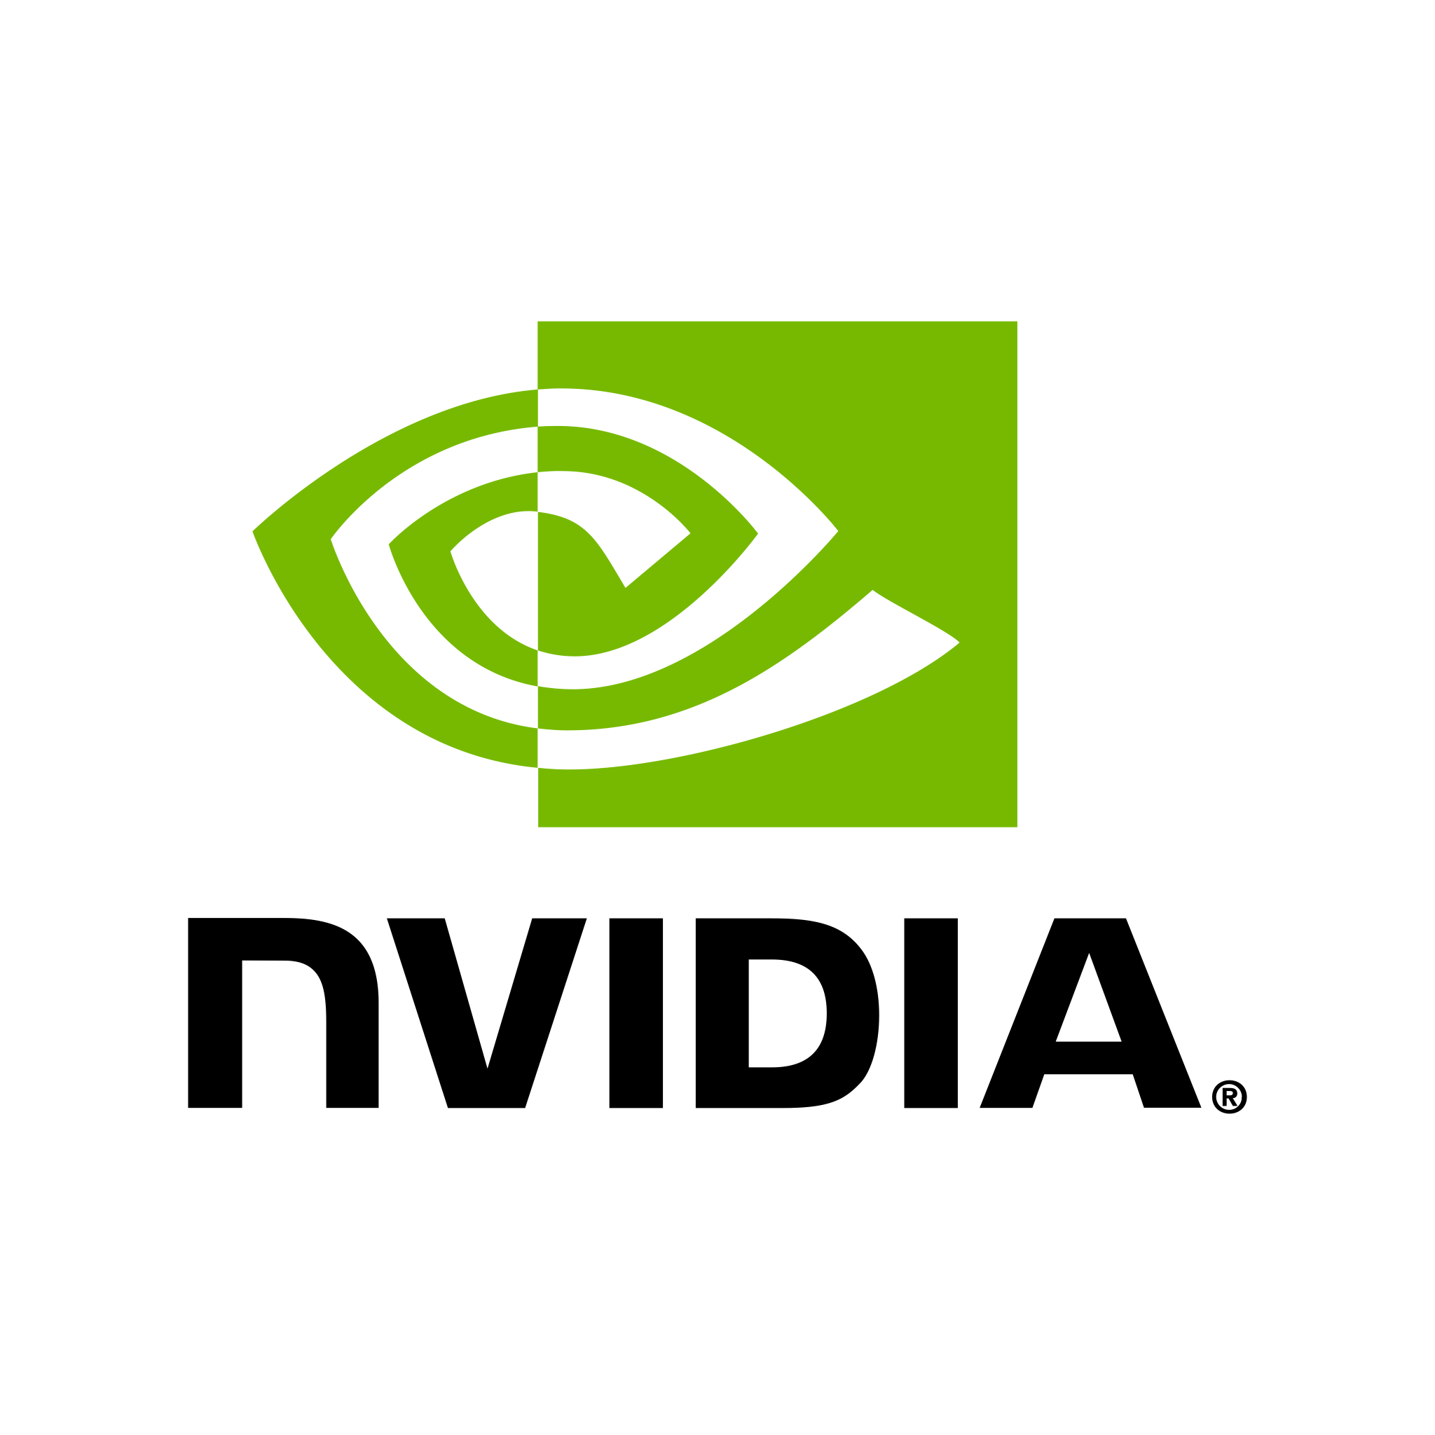

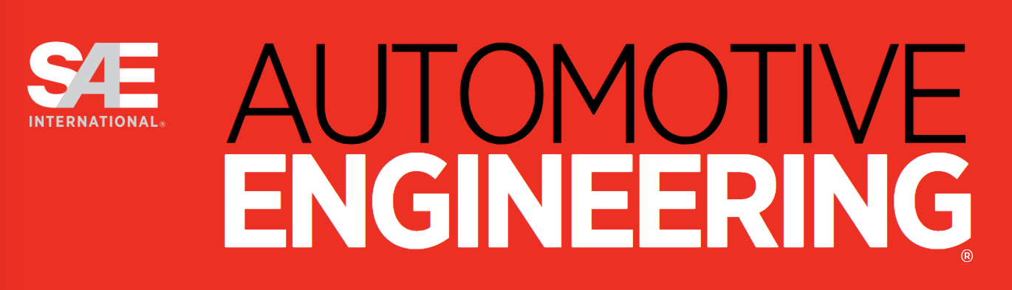



About Us
Founded in 2020
SkillReal Platform Core IP:
Fusing patented computer vision calibration technology with accelerated large AI models resulting best-in-class 99.7% Confidence
Vision Based Platform - Patented Undistortion and Correction Algorithm
Digital Twin Alignment (CAD) with Sub-mm Accuracy to the CAD Model
Inspection of Feature Presence, Location, dimensions and quality
Capable for Dimensional Repeatability within GD&T Specification
Detection Customizable with SkillReal’s AI pipeline
Edge deployed software running on dedicated hardware without external internet connection
Systems deployed globally with 15 OEMs & Tier 1s including Magna, VW, and leading US & Japanese OEMs
Notes:
2. Our technology is a mixture of cutting-edge AI along with classical computer vision – essentially, we use AI for what AI is good for but due to our advanced CV and DTA we also provide highly accurate dimensional measurements of features on your parts.
3. As compared to our competitors who are comparing to a master part/image we reference back to the CAD

Slide 3

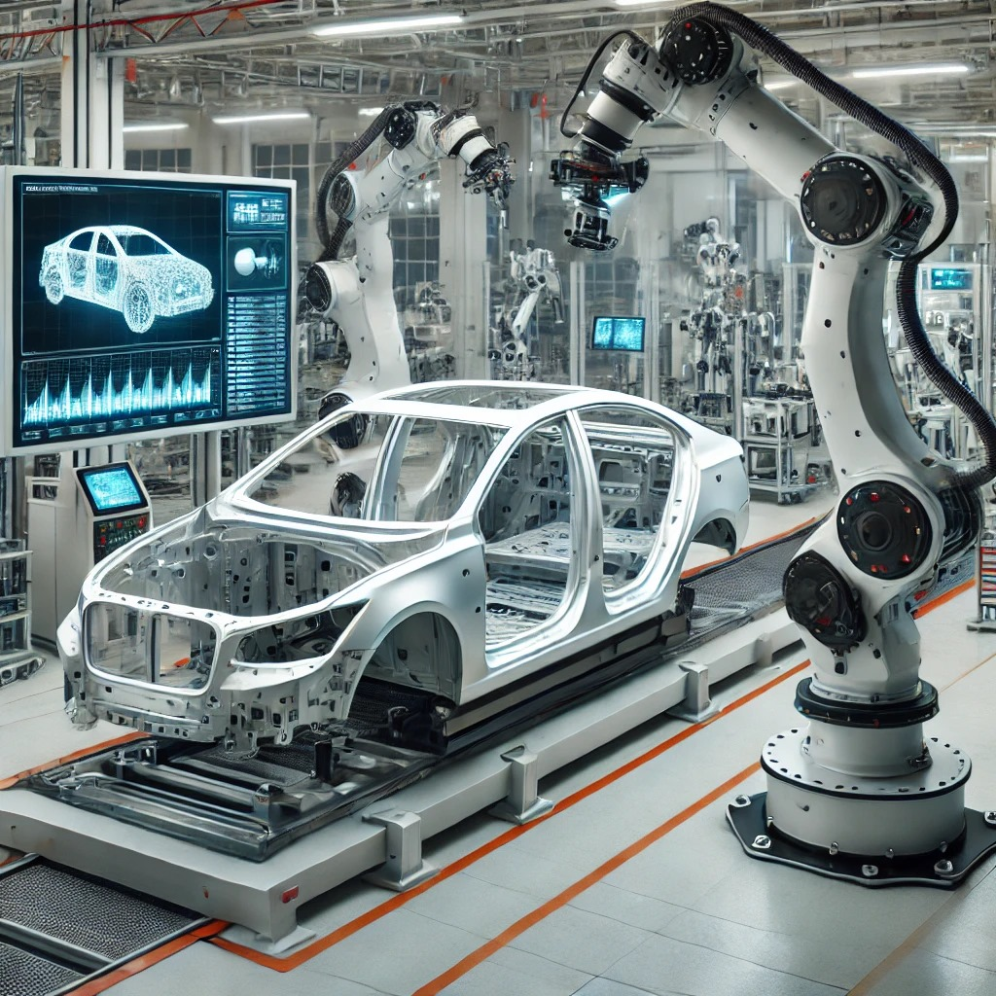


The Current Inspection Solutions
>$51B
Lost
The cost of delays reworks & recalls in the automotive industry
*warrantyweek.com. (2024). Worldwide Auto Warranty Report October 2024
Manual Inspection
Automated Inspection
Very Slow & Costly
Up to 30% of labor hours spent on quality control
Error-prone & inconsistent
Skilled workforce is limited
Complex & Expensive
Large footprint
Usually, EOL line only
Partial inspection to meet cycle time

Slide 4

The World’s first in-line 3D-AI solution to deliver sub-mm accuracy,
at cycle time with >99.7% confidence
Cost effective, flexible, enabling upstream and end of line inspection within existing assembly line footprint

Slide 5
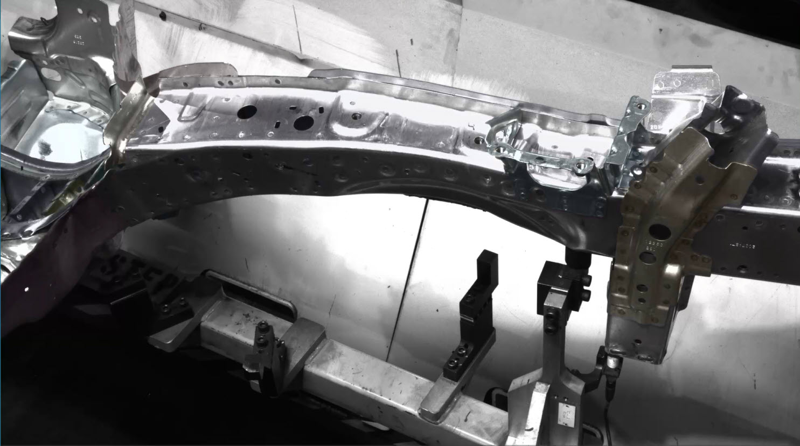


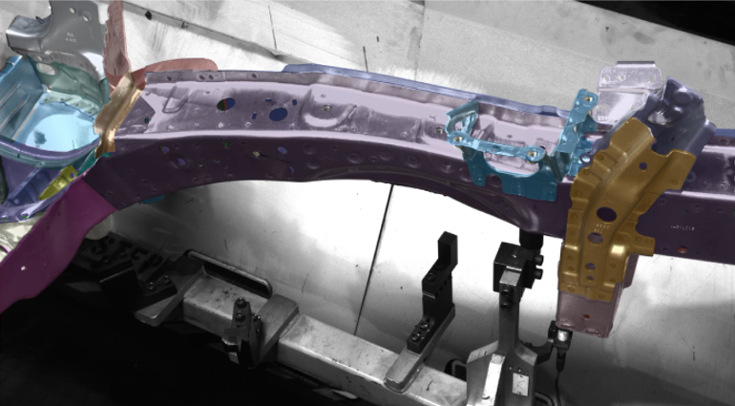
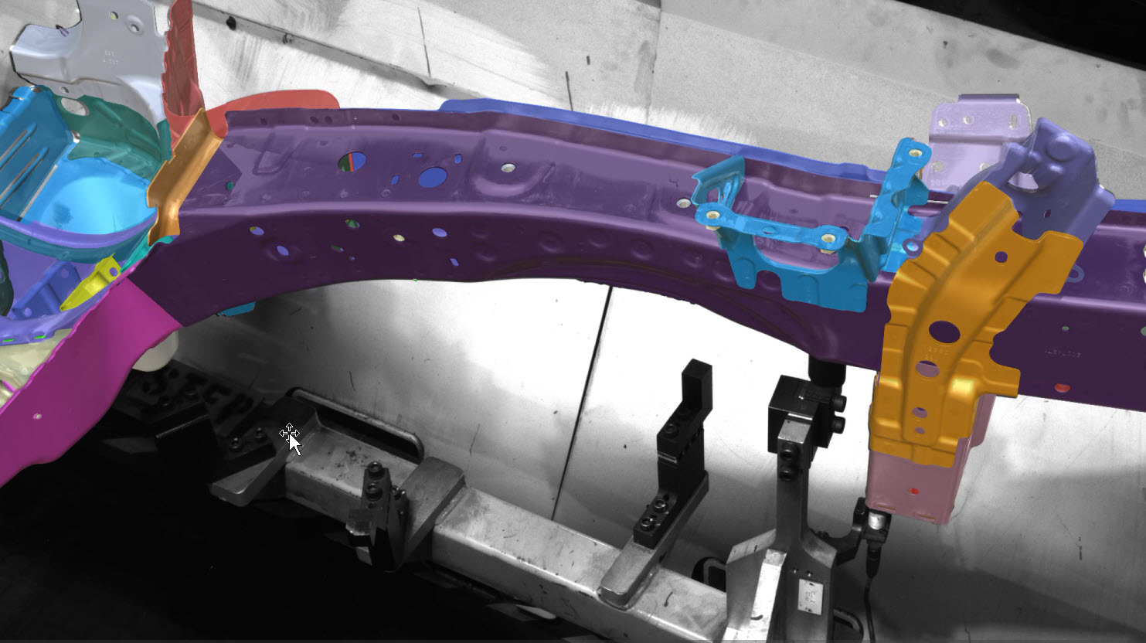
SkillReal Technology - 4 Steps
01
02
Sub-Pixel Camera calibration
Real Time CAD-Based Alignment
Proprietary computer vision algorithms transform standard cameras into high-precision 3D sensors by correcting lens and sensor distortions in real time, with sub-pixel accuracy across the entire field of view
AI-powered detection and proprietary 3D algorithms track parts with high precision, aligning each part to its CAD model for accurate 3D measurement and verification according to GD&T—inline, without jigs, complex fixturing, or robots
Before calibration
After calibration

Slide 6
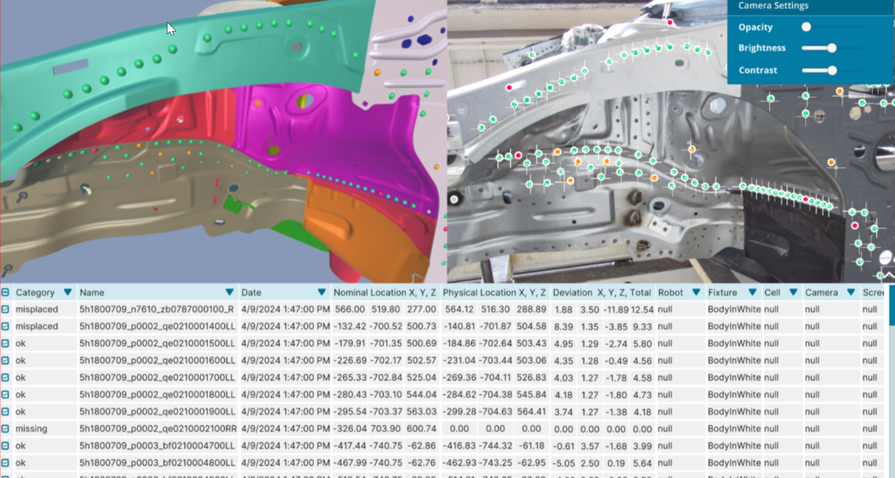
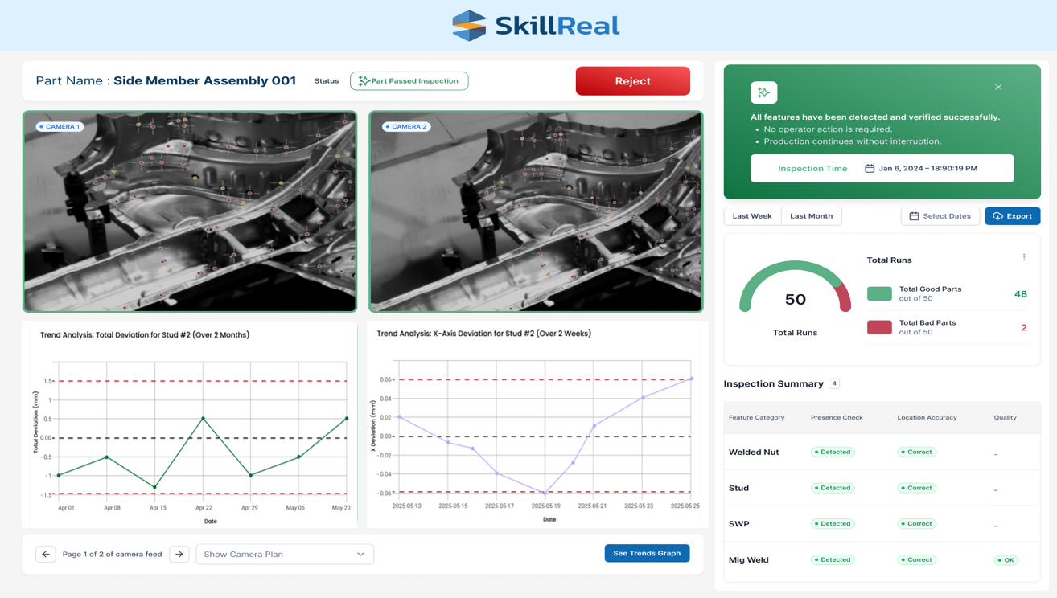
SkillReal Technology - 4 Steps
03
04
Accelerated Large Pre-trained 3D Dimensional AI models
Open Platform and Advanced Analytics
Advanced analytics , AI and custom dashboards provide role-specific insights, and full digital traceability. Integrates with PLC, HMI and other factory systems to deliver real-time data for immediate corrective actions and quality improvement.
Patented algorithm accelerates large pre-trained AI models by fusing them with geometric 3D data, enabling in-cycle inspection of 100% of features with high accuracy. Verifies presence, location and quality, with >99.7% reliability
Notes:
Factory

Slide 7
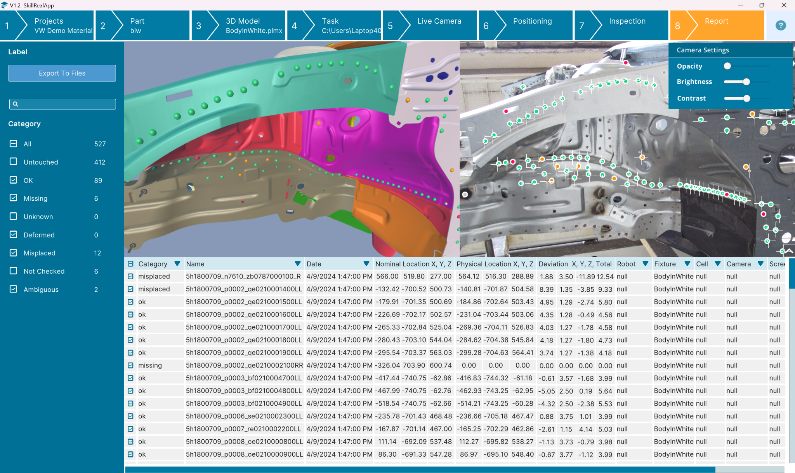
Results
Comprehensive Report Exported to PLC Alerts to Defects in Real Time, Saving Labor Costs, and Reducing Scrap

Slide 8
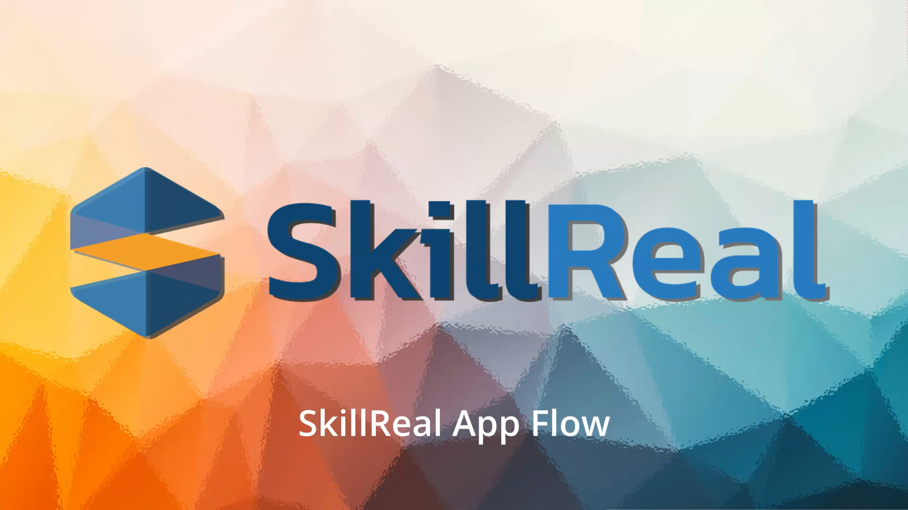

Slide 9
Catalog of Base AI Models
Manufacturing Feature Inspection | Status | Key Abilities
Spot Welds | Available Now! | Presence and Location Check
Self-Piercing Rivets (SPRs) | Available Now! | Presence and Location Check
Welded Studs | Available Now! | Presence and Location Check
Holes (With IR light) | Available Now! | Presence and Location Check
Weld Nuts | Available Now! | Presence and Location Check
Rivet Nuts | Available Now! | Presence and Location Check
MIG Welds | Available Now! | Presence, Location, Length Check
MIG Weld Quality | Available Now! | Porosity and Seam Check
Flow Drill Screws (FDSs) | Available Now! | Presence and Location Check
Pre-trained Large AI model detects BIW features out of the box, additional feature detection customizable with SkillReal’s AI pipeline

Slide 10





Summary
Unmatched Precision – 99.7% accurate quality inspection capable to GD&T specifications
Cost Savings – Minimizes rework, recalls, downtime
Fast Adjustments – Quick engineering changes implemented via CAD integration
Seamless Integration – Retrofit existing production lines easily with zero footprint
Full Inspection – Validates 100% parts and features within cycle time
Enhanced Efficiency – Automates inspection, boosts speed

Slide 11


Slide 12

Business Case Perpetual Model: Significant ROI at Large Tier 1
3 Operators Replaced:
$225,000/year in labor savings
System Cost: $290,000 one-time + 15% annual maintenance
Payback Period:
<12 months
Ongoing Savings: Over $800k in 5 years for one station
This data reflects a SkillReal deployment at a large Detroit based automotive supplier. Labor savings we achieved by replacing manual EOL inspection with fully automated, in-line checks powered by SkillReal's digital twin alignment platform

Slide 13
Business Case Subscription Model: Fast ROI at Large Tier 1
Initial Integration cost $35,000
Monthly fee $3,500
Monthly Hard savings of $12,500 (Operator’s reduction of 3 shifts)
Additional quality savings – the system detected spills that did not be detected by operators
Deducting one-time integration cost, infer the Immediate earnings from the 1st month

